Slide 1


DATA VISUALIZATION PROJECT
BY TEAM LUMIGRAPH
Created by
Neeraj yadav (21f3002261)
Banoth Pavan (21f1002144)
Shivendra Patel (21f2001310)
Thoomati Aditya Vikram (21f1000610)

Slide 2






Project Approach
Data Collection
Data
Understanding
Data Preprocessing
Exploratory Data Analysis (EDA)
Trend Analysis & Insights
Identifying Gaps & Opportunities for Improvement

Slide 3
Data Collection
File name | Description
Amazon Sale Report | Amazon sales transactions with SKU, ASIN, quantity, fulfillment, and amount.
Cloud Warehouse Comparison Chart | Compares profitability across platforms like Shiprocket and INCREFF.
Expense IIGF | Revenue and expense tracking for e-commerce operations.
International Sale Report | Global transactions including SKU, customer, and pricing.
May-2022 Sales Data | Monthly product sales and pricing info for May 2022.
P & L March 2021 | Multi-platform pricing, product weight, and profit/loss data.
Sale Report | Detailed SKU-level product info (stock, size, color , category).

Slide 4
Data Interlinking
01
SKU codes unify sales, inventory, pricing, and platform data across files.
02
Time-based attributes allow monthly or seasonal trend analysis.
03
Fulfillment & platform metrics enable operational comparison.

Slide 5
Data
Overview

Slide 6
Data Overview
Dataset Name | Shape (Rows, Columns) | Key Features | Missing Values
Amazon Sale Report | 128,975, 23) | Orders, SKUs, Fulfillment,Sales,Shipping | Promotion_IDs (49,153)
Cloud Warehouse Comparison Chart | (50,4) | Performance of Shiprocket vs. INCREFF | Shiprocket (29), INCREFF (22)
Expense IIGF | (Varies) | Revenue & expenses from e-commerce sales | Some missing financial records
International Sale Report | (Varies) | Global sales, SKUs, customers, pricing | Missing values in product details
May-2022 Sales Data | (Varies) | Monthly e-commerce sales | Some missing product attributes
P & L March 2021 | (Varies) | Profit/Loss details across e-commerce platforms | Stock levels, pricing gaps
Sale Report | (Varies) | SKU tracking, product details, stock, colors | Product details missing in some cases

Slide 7
Data Overview
Key Insights from Data
The Amazon Sale Report has 128,975 records with 23 attributes, capturing order details, fulfillment status, and transaction data.
The Cloud Warehouse Comparison Chart contains performance metrics but has some missing values, especially in Shiprocket & INCREFF performance data.
Expense IIGF dataset provides financial tracking but has some gaps in revenue data.
International Sales & Monthly Sales Reports track e-commerce transactions across platforms.
Profit & Loss Data (P&L March 2021 & May 2022 ) highlights pricing structures and profit margins for different e-commerce websites.

Slide 8
Data
Preprocessing

Slide 9
Data Preprocessing & Cleaning
Key Cleaning Steps (Amazon Sales Report)
Cancelled Orders: Set Sale_Amount=0 and Currency="INR".
Missing Courier_Status: Filled with "Adjustment."
Missing Currency: Filled with "INR."
Missing Sale_Amount: Replaced with 0.
Validation: Checked unique values and statistics.
Formatted Shipping states and city, corrected misspelled names
Key Cleaning Steps (International Sales Report)
Dates: Converted Sale_Date to datetime format.
Missing Sale_Month: Filled from Sale_Date (36,391 rows).
Product SKUs: Standardized naming conventions.
Key Cleaning Steps (Warehouse Data Cleaning)
Pricing Data: Removed symbols, converted to numeric.
Operations: Forward-filled process stages.
KPIs: Dropped incomplete rows.
Contract Terms: Cleaned clause text.
Key Cleaning Steps (Sales Report)
Dropped redundant index column.
Removed rows with missing Product_SKU (Critical Identifier).
Key Cleaning Steps (P&L Datasets)
No cleaning needed (complete data).
Impact of Cleaning
Handled missing/cancelled orders (Amazon).
Standardized dates & product info (International).
Structured warehouse data for analysis.
Ensured integrity by dropping invalid rows.

Slide 10
Data
Analysis

Slide 11
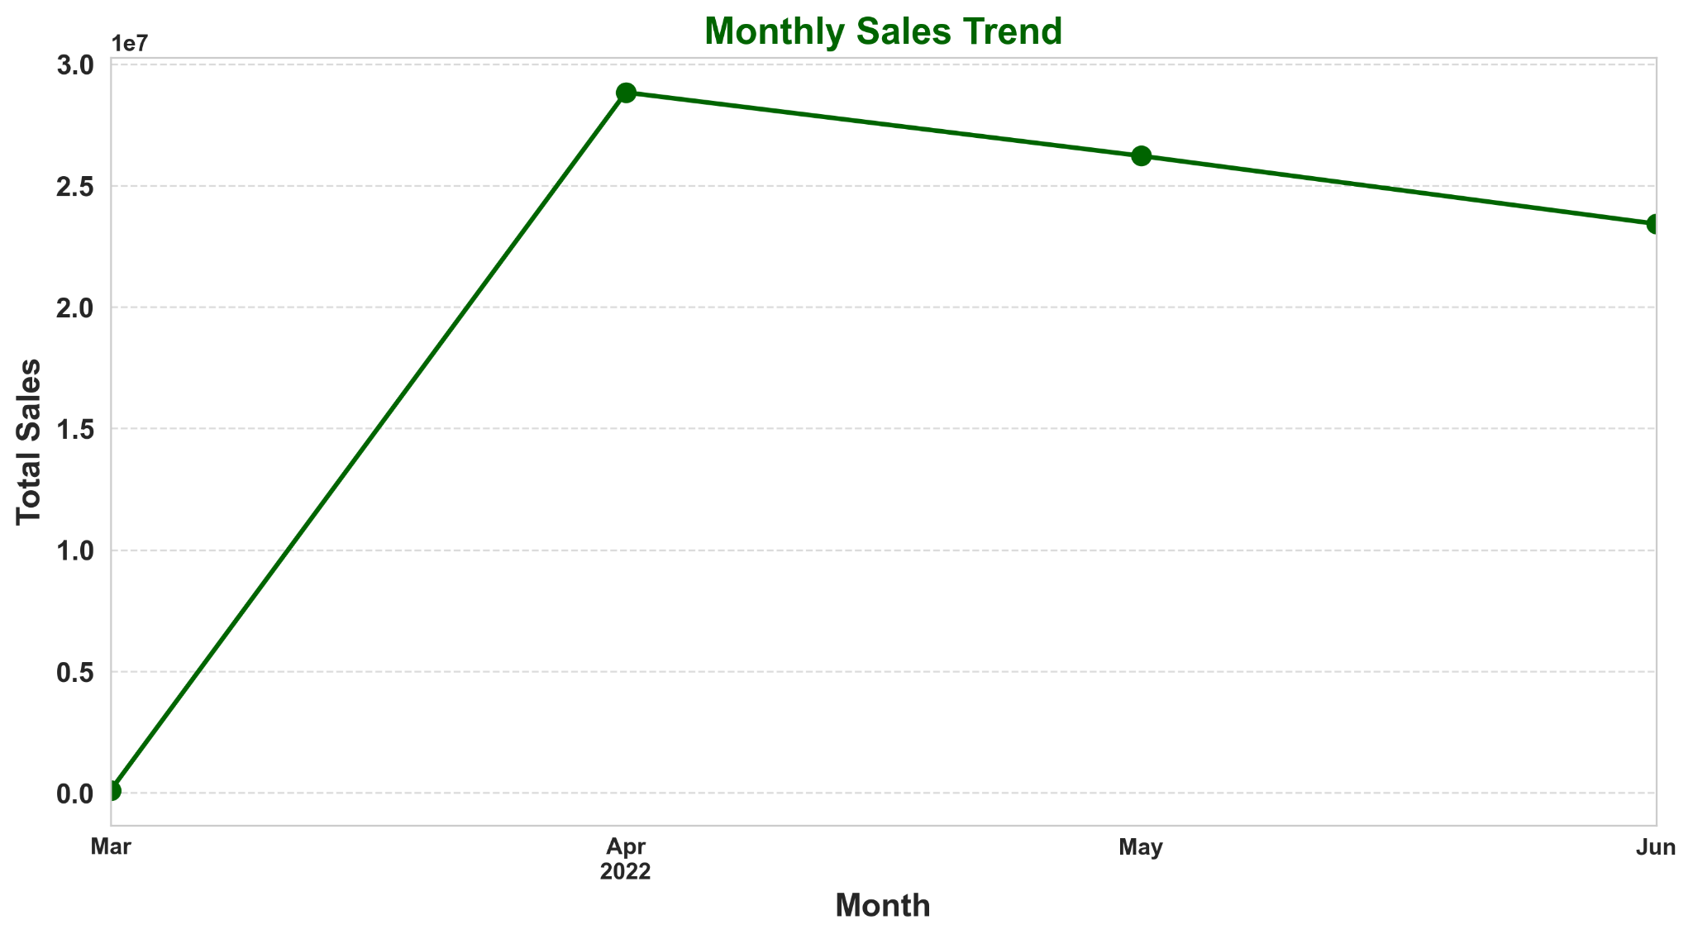
Amazon Sales Overview
01
Amazon Sales Overview
Total Sales Entries: 128,942
Average Sale Amount: 609.37
Minimum Sale Amount: 0
Maximum Sale Amount: 5,584
Insights:
April has the highest amount of Sales
02
Sale Amount Distribution:
25th Percentile: 413
50th Percentile (Median): 583
75th Percentile: 771

Slide 12
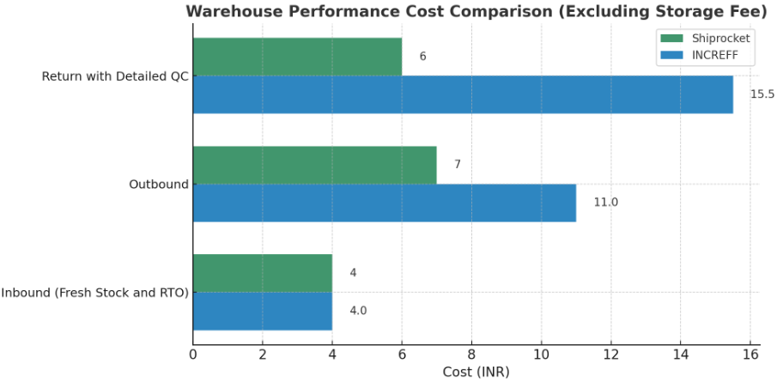
Warehouse Performance Comparison Overview
01
Shiprocket Price
Inbound (Fresh Stock and RTO): Rs. 4
Outbound: Rs. 7
Storage Fee/Cft: Rs. 25
Customer Return with Detailed QC: Rs. 6
02
INCREFF Price:
Inbound (Fresh Stock and RTO): Rs. 4
Outbound: Rs. 11
Storage Fee/Cft: Rs. 0.15/Day
Customer Return with Detailed QC: Rs. 15.5
Insights:
Shiprocket seems to offer more predictable costs for storage and lower costs for outbound and return services.
INCREFF might be more suitable for businesses with short-term storage needs and fewer returns.

Slide 13
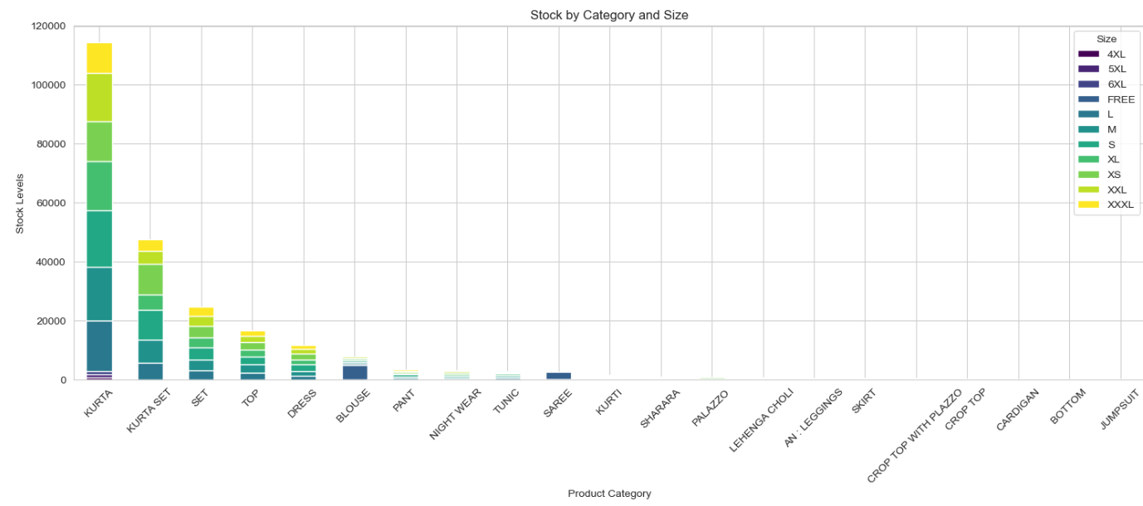
Sales Report Overview & Product Insights
01
Stock Level Summary
Total Products: 9,188
Average Stock: 26.38 units
Max Stock: 1,234 units
Insights: Fast moving items such as Kurta and Kurta Set have the most amount of inventory
02
Top Product
Categories
by Share
Kurta: 40.31%
Kurta set: 17.37%
Set: 11.42%
Top: 9.37%
Dress: 7.61%
Other categories include BLOUSE, NIGHT WEAR, TUNIC, SAREE, and more.
03
Size Availability
5XL: 32 units
4XL: 31 units
6XL: 30 units

Slide 14
Sales Trends
Identified patterns in sales across different months, product
categories, and fulfillment methods.

Slide 15
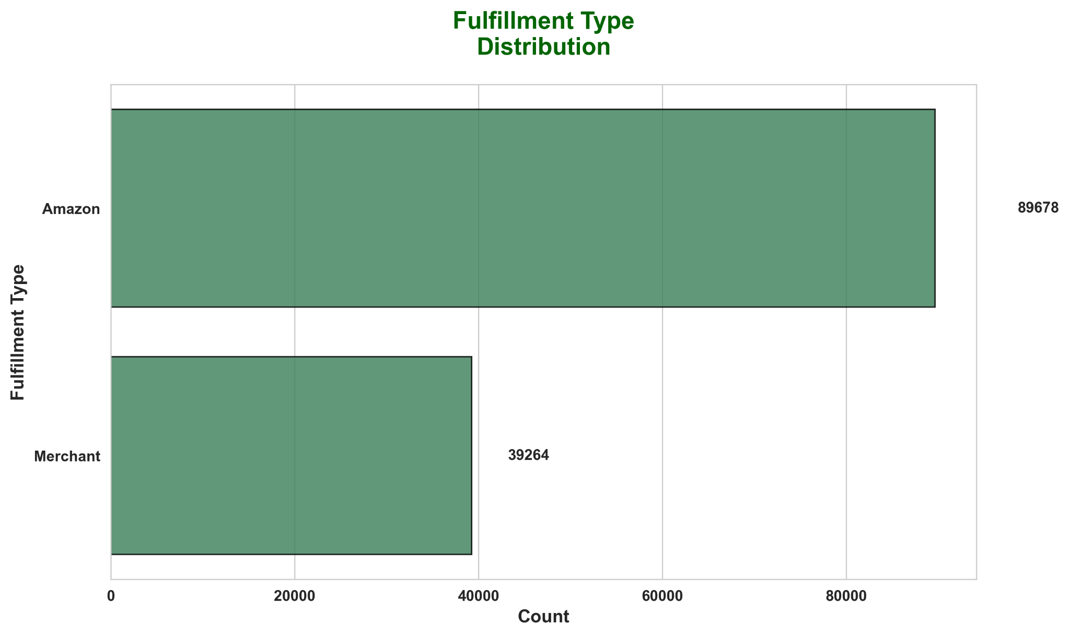
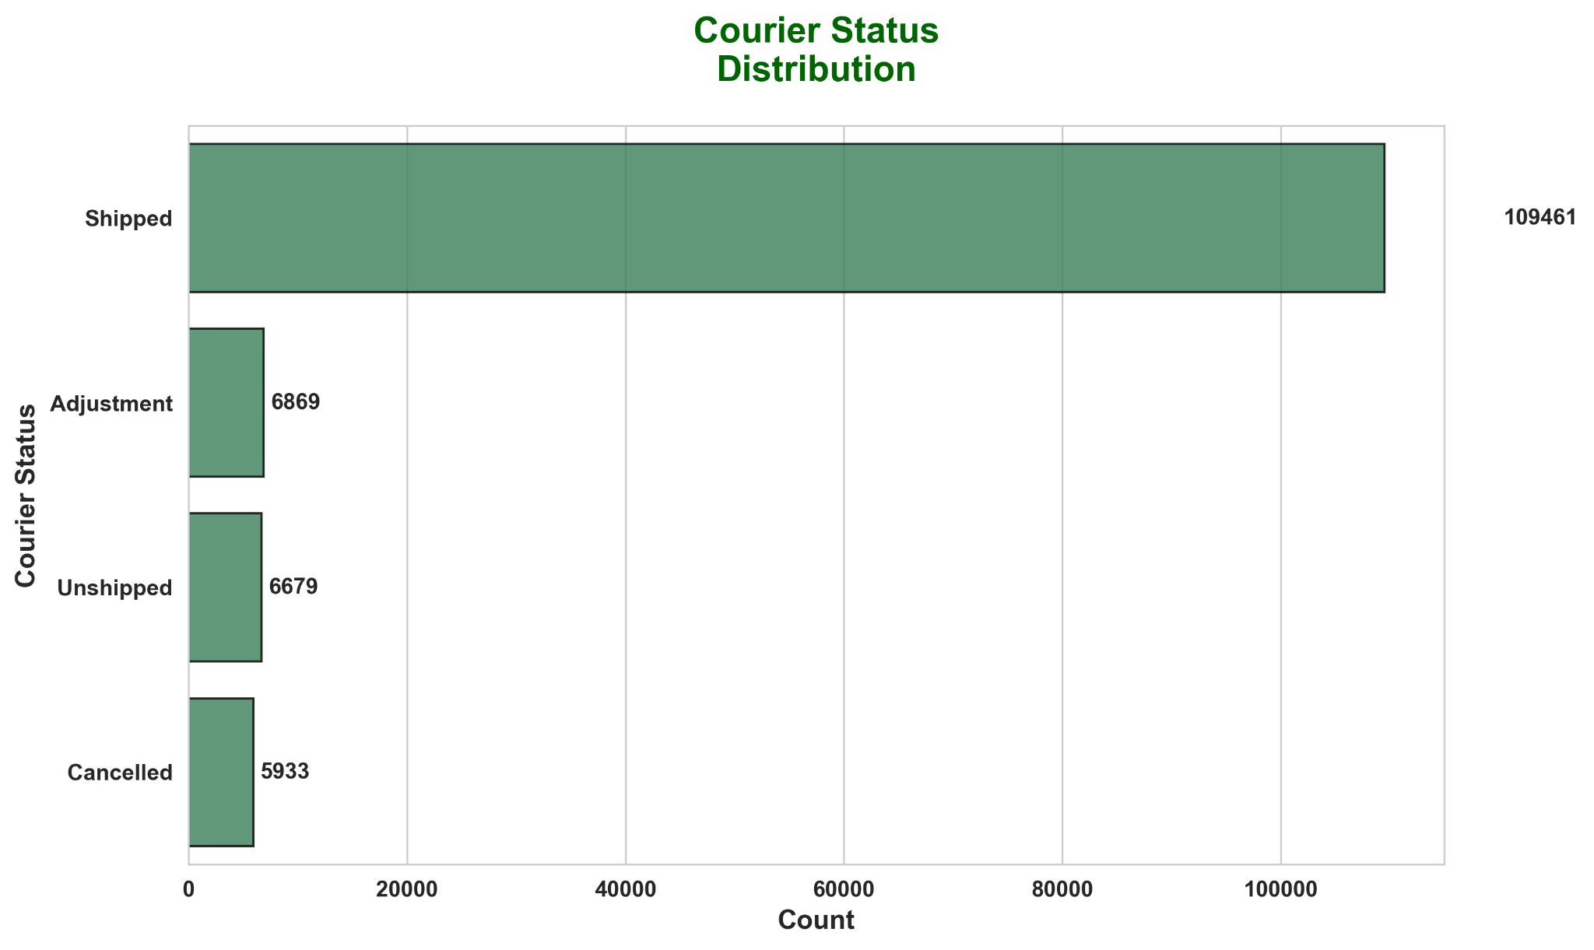
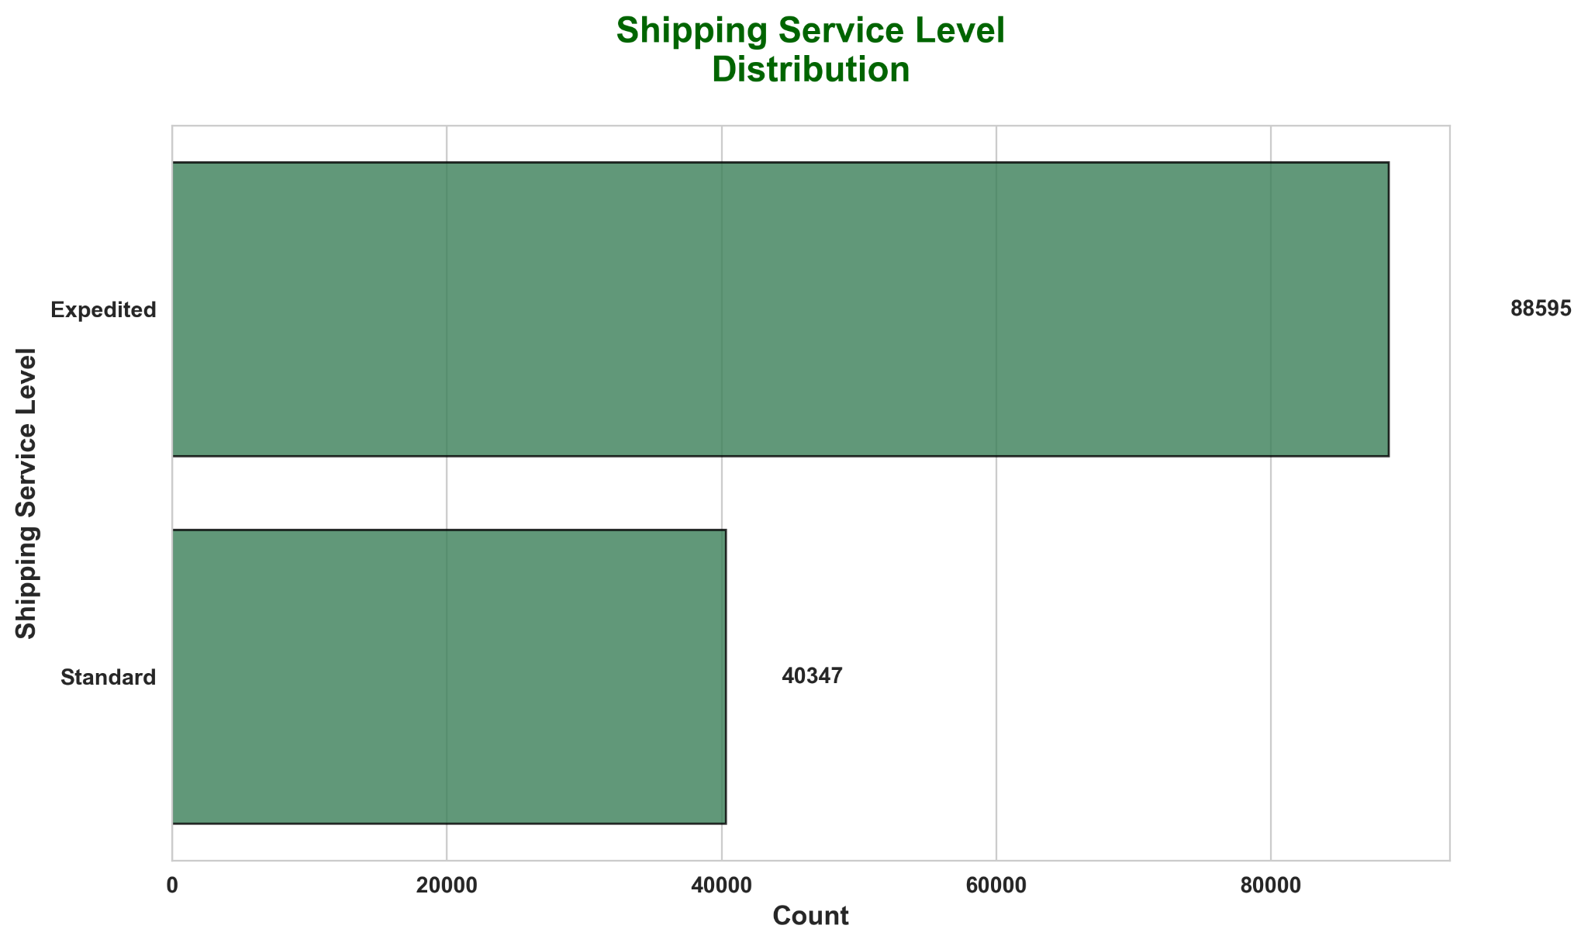
Amazon Sales Performance: Key Distribution Patterns
Insights:
Expedited Orders being more than the Standard shipping shows that the consumers are looking for last minute/urgent deliveries, preferring Amazon’s faster delivery
Standard orders also have a higher cancellation rate.

Slide 16
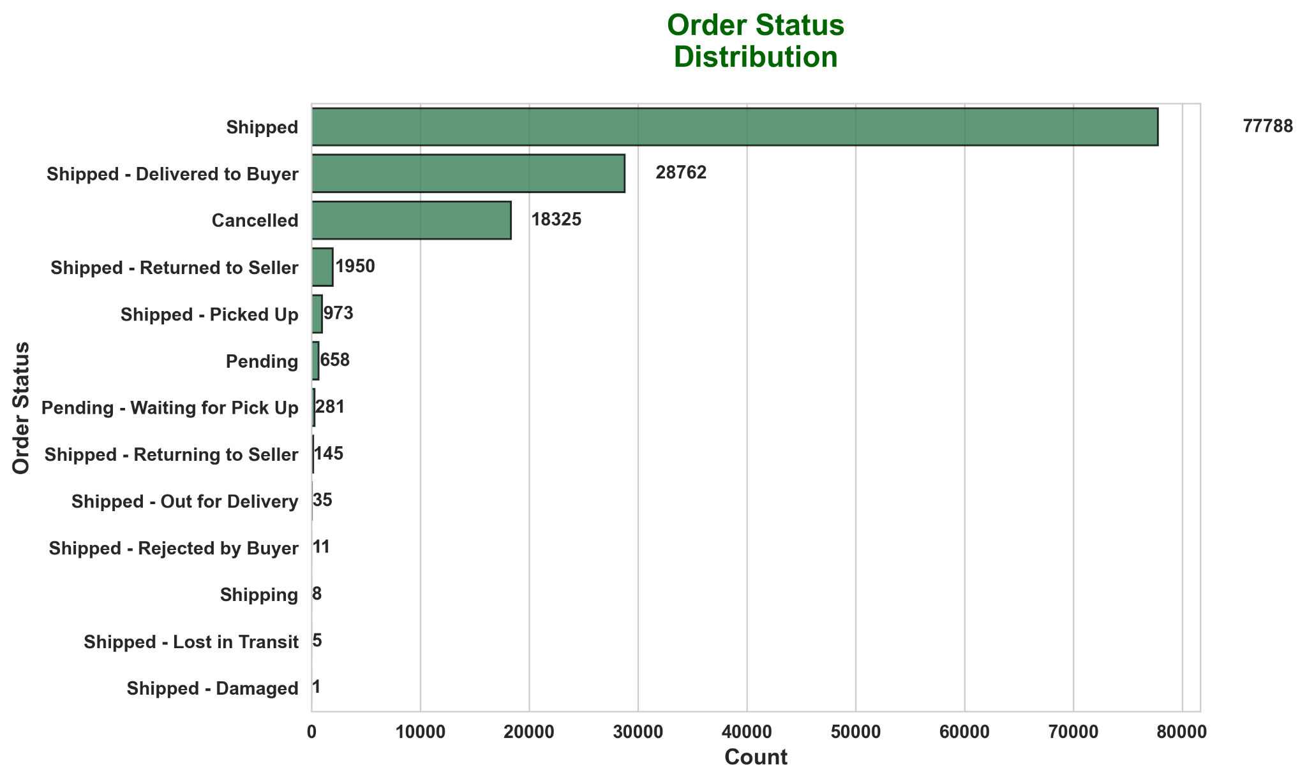
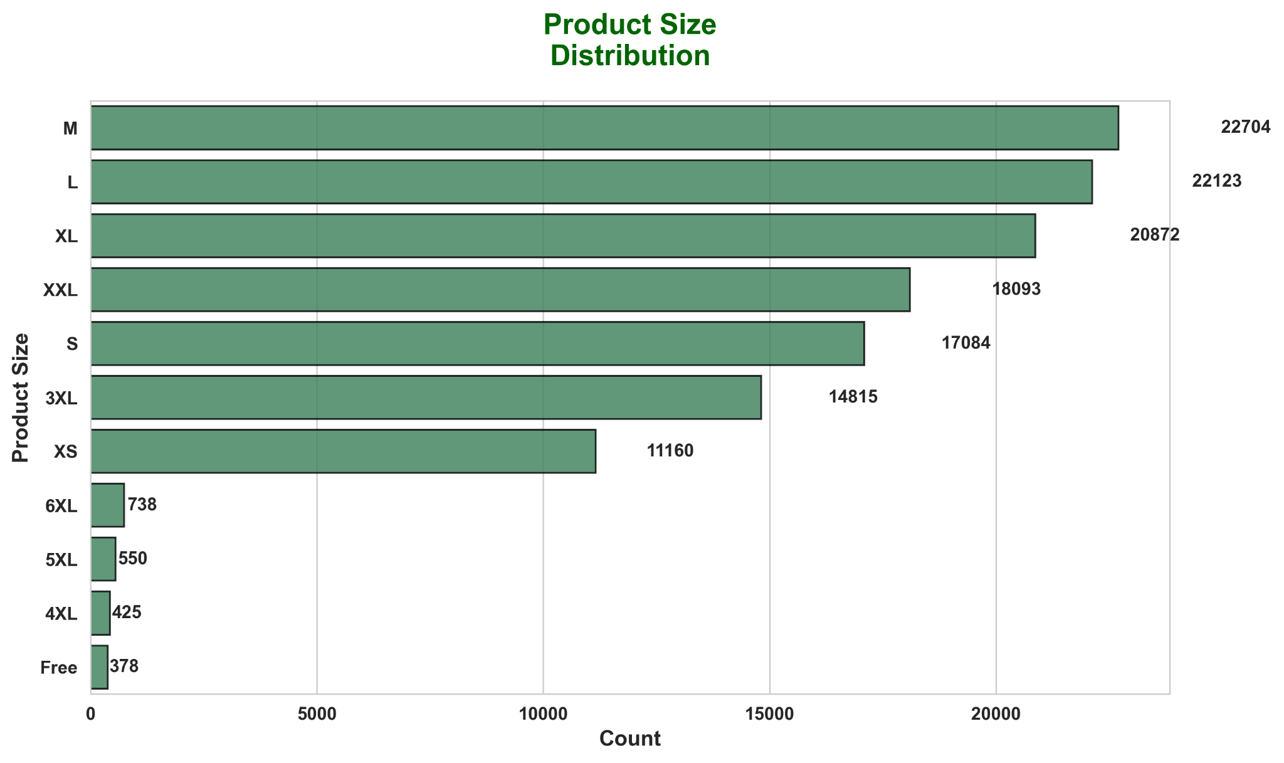
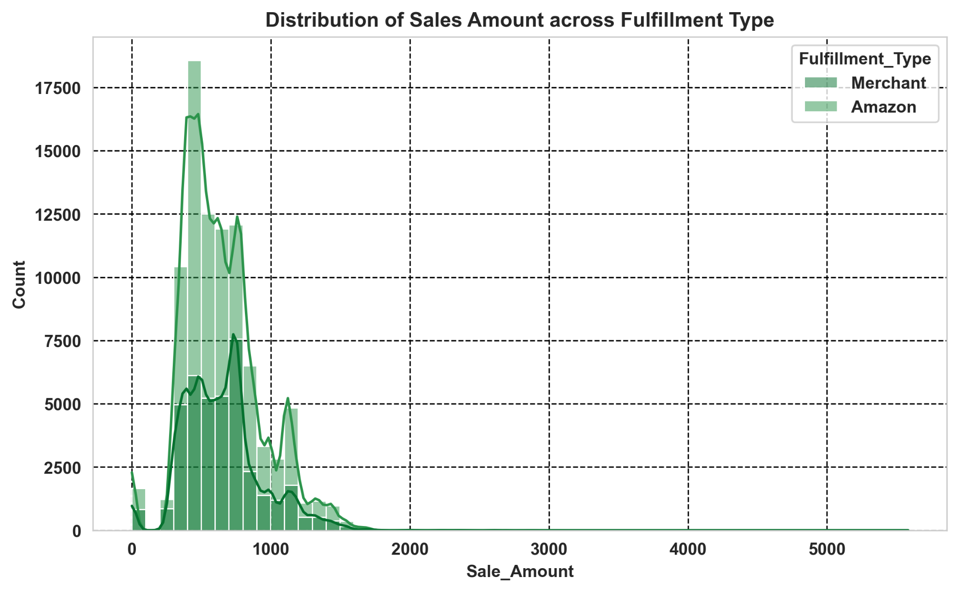
Amazon Sales Performance: Key Distribution Patterns
Insights:
Amazon as a shipping channel is preferred for lower value products.

Slide 17
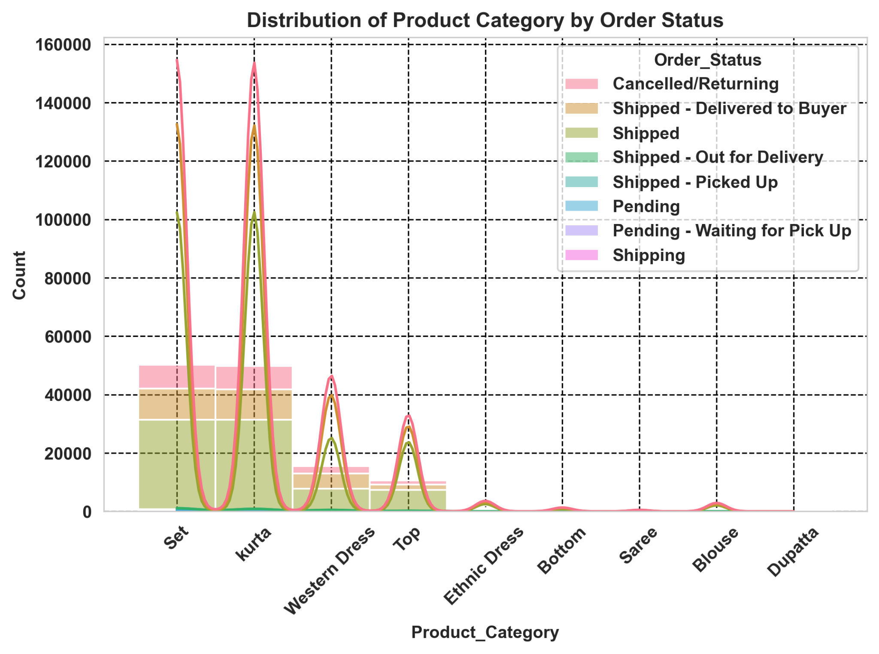
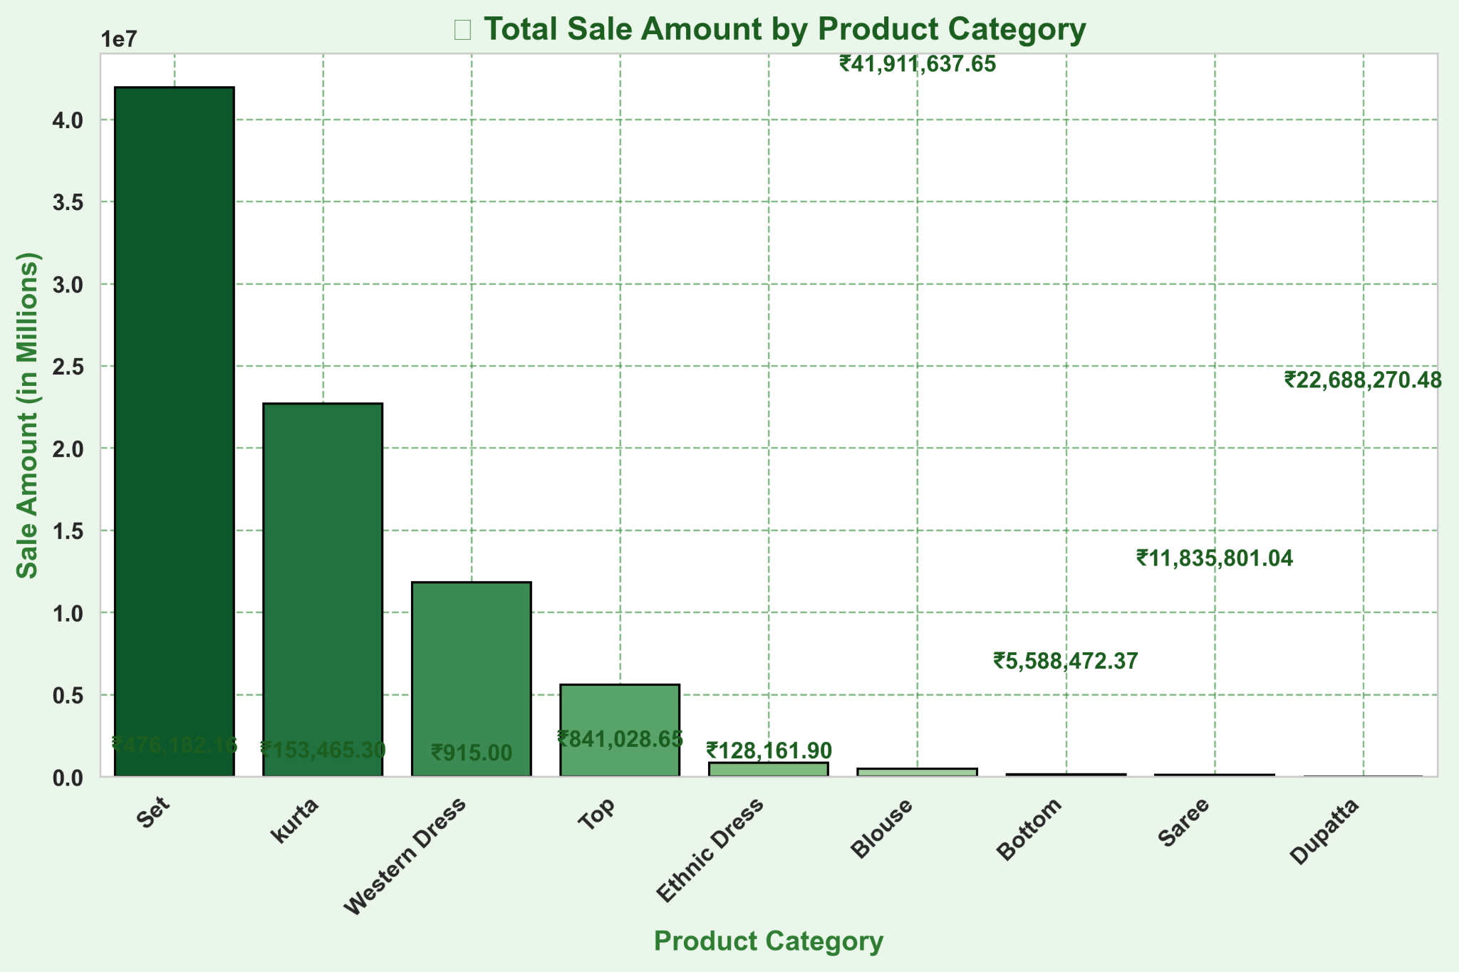
Product Category
Insights:
Though Kurta sells a lot in number, Kurta Set brings the most amount of revenue.

Slide 18
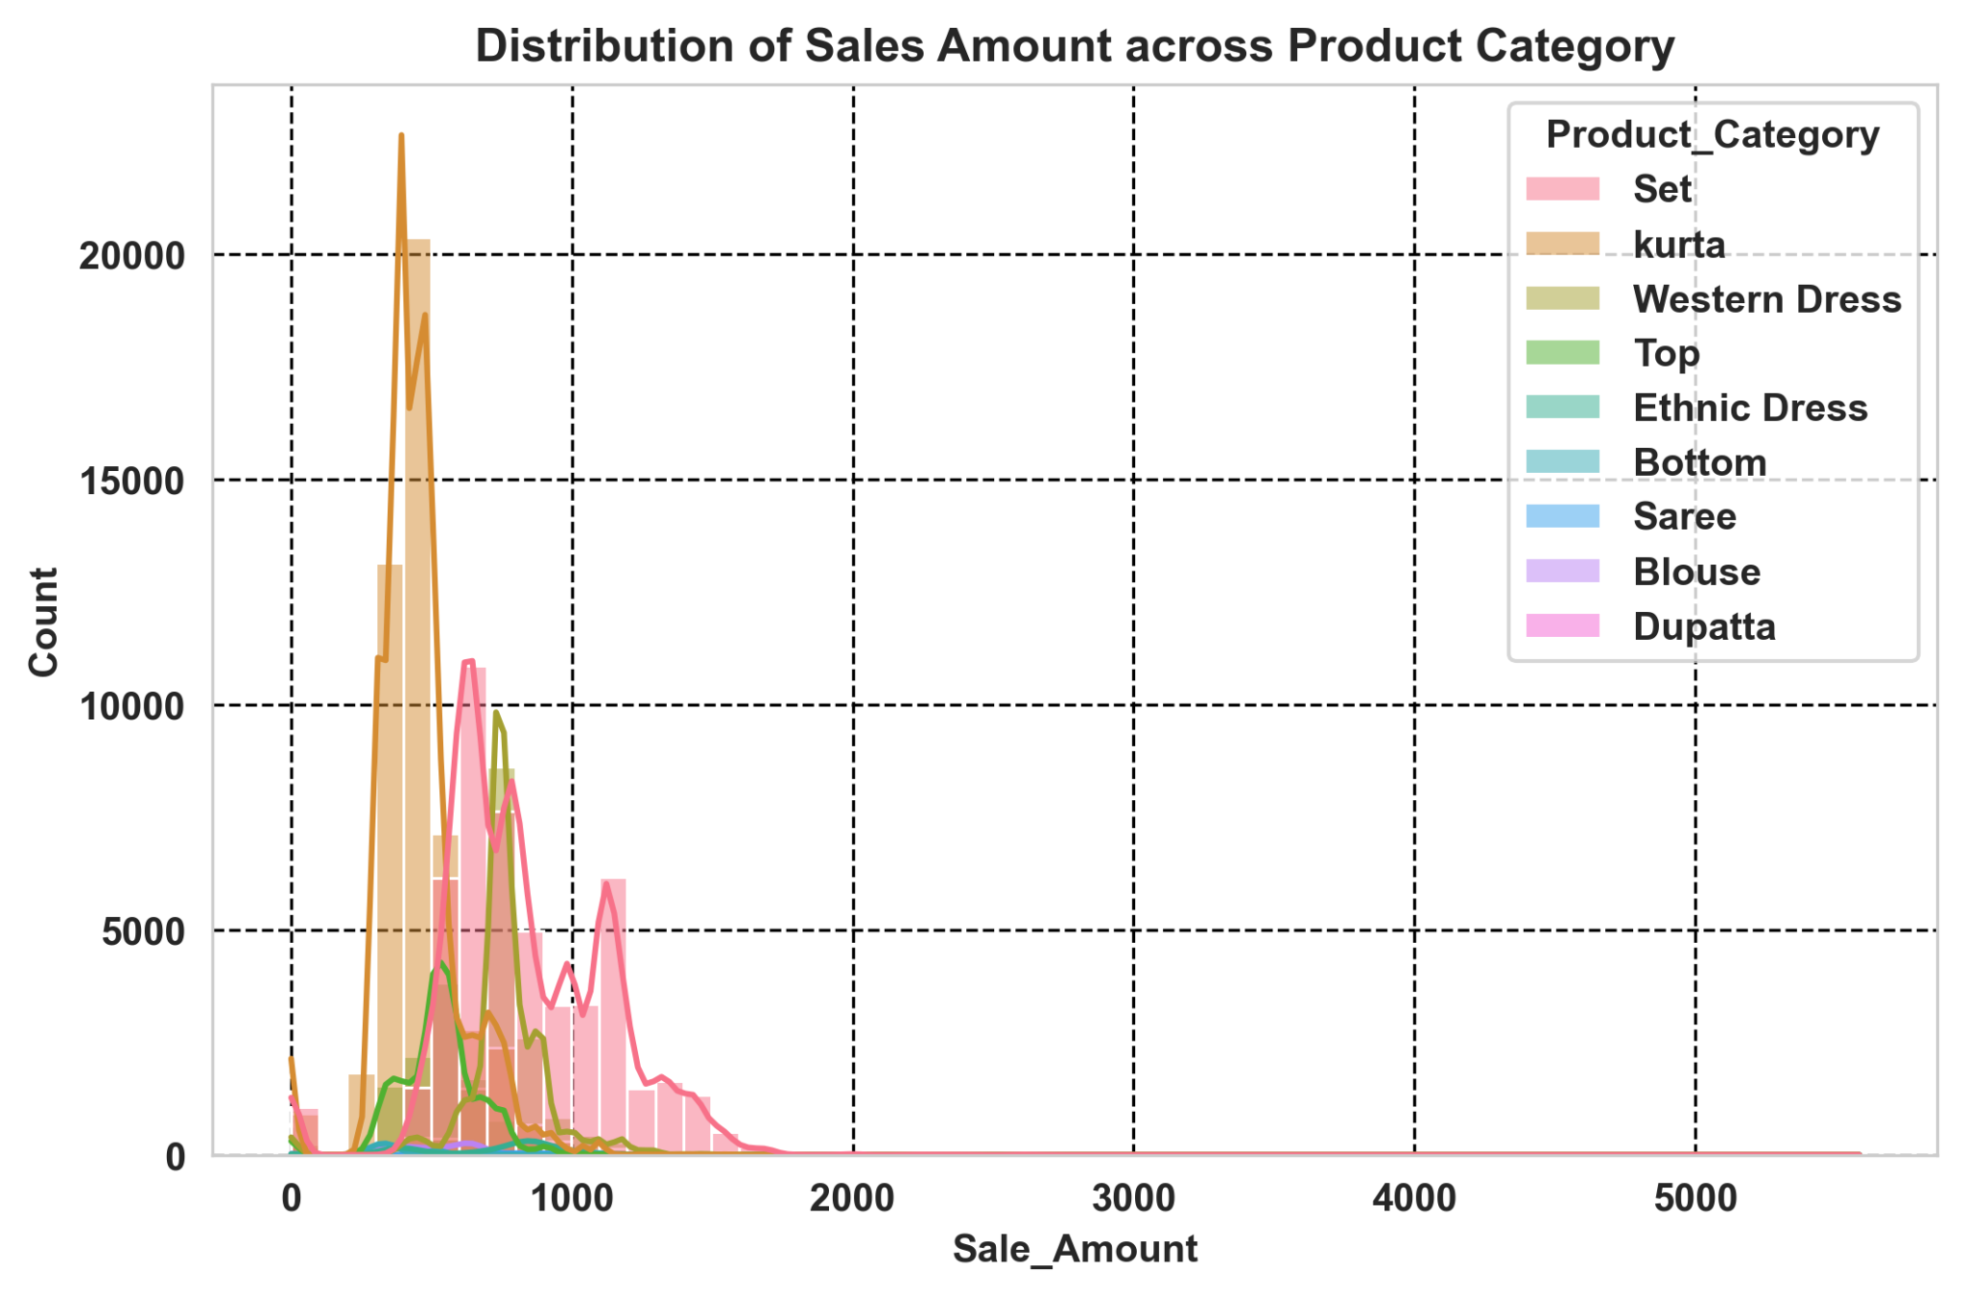
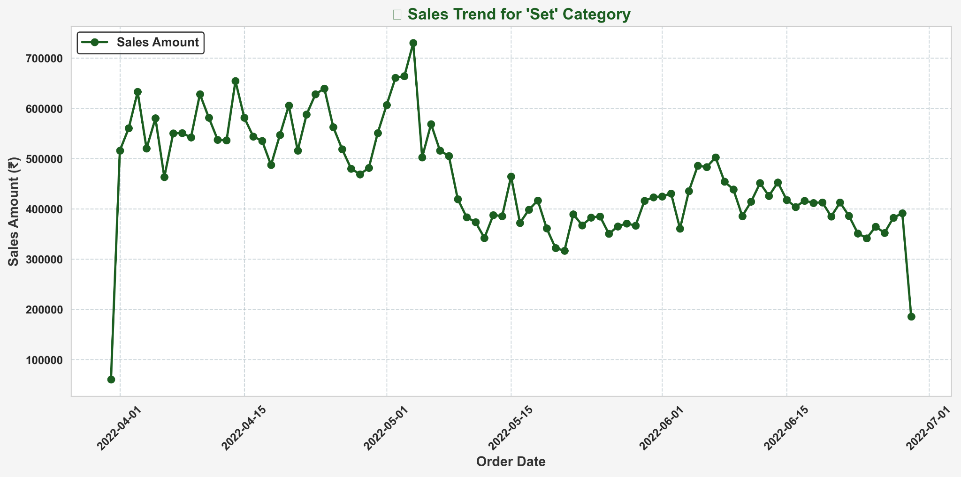
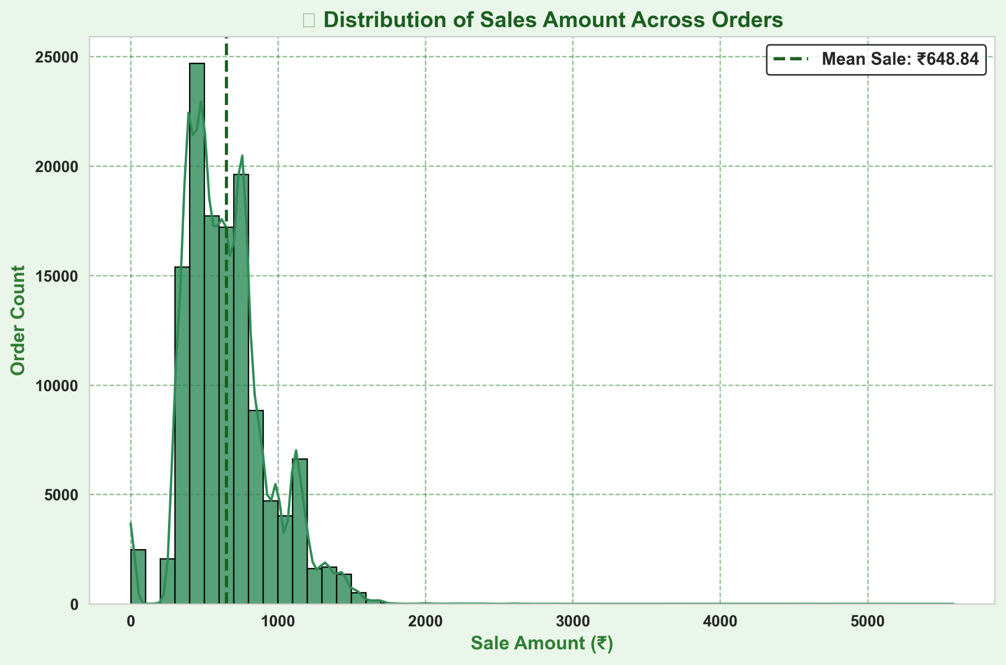
Sales Trend and Sales Amount Distribution
During which season or time period should we concentrate more on the best performing category in the Amazon Sale Report, and what are the reasons for this focus?
The "Set" category demonstrates the highest performance, peaking in April. To capitalize on this trend, it is advisable to launch marketing campaigns targeting this category in March. Although performance starts to decline from May onwards, it remains relatively stable over several months. Therefore, maintaining marketing efforts for the "Set" category throughout the year could be beneficial.

Slide 19






Sales by Product Category (March)
Blouse
Western Dress
Sale Amount : 280.00
Sale Amount : 7653.28
Ethnic Dress
kurta
Sale Amount: 1,099
Sale Amount: 34256.57
Set
Sale Amount: 53,884
Top
Sale Amount: 4,511
Month: March

Slide 20


Sales by Product Category (April)
Blouse
Western Dress
Sale Amount : 195583.21
Sale Amount : 2927780.51
Ethnic Dress
kurta
Sale Amount: 250666.65
Sale Amount: 8013898.48
Set
Saree
Sale Amount: 15502956.56
Sale Amount: 55655.24
Top
Bottom
Sale Amount: 1821400.22
Sale Amount: 63308.45
Month: April

Slide 21
Sales by Product Category (May)
Blouse
Western Dress
Sale Amount : 159794.68
Sale Amount : 4381304.41
Ethnic Dress
kurta
Sale Amount: 293092.34
Sale Amount: 6657168.62
Set
Saree
Sale Amount: 12640967.35
Sale Amount: 41536.62
Top
Bottom
Sale Amount: 1995120.16
Sale Amount: 50866.57
Month: May

Slide 22

Sales by Product Category (June)
Blouse
Western Dress
Sale Amount : 102750.29
Sale Amount : 3898599.49
Ethnic Dress
kurta
Sale Amount: 246359.67
Sale Amount: 6586215.03
Set
Saree
Sale Amount: 10997368.12
Sale Amount: 26741.90
Top
Bottom
Sale Amount: 1525780.92
Sale Amount: 36492.96
Dupatta
Sale Amount: 915.00
Month: June
Set and Kurta categories consistently dominate sales, showing strong performance across all months, suggesting they are evergreen staples in customer wardrobes.
Western Dress and Top categories see peak sales in months 4 and 5, possibly indicating seasonal spikes—like summer or wedding seasons—where lighter or fashionable wear is preferred.
Seasonal demand is evident for niche items—Dupatta appears only in June (month 6) and Bottoms see reduced presence after month 5, indicating these products may align with specific festivals, regional fashion cycles, or promotions.

Slide 23
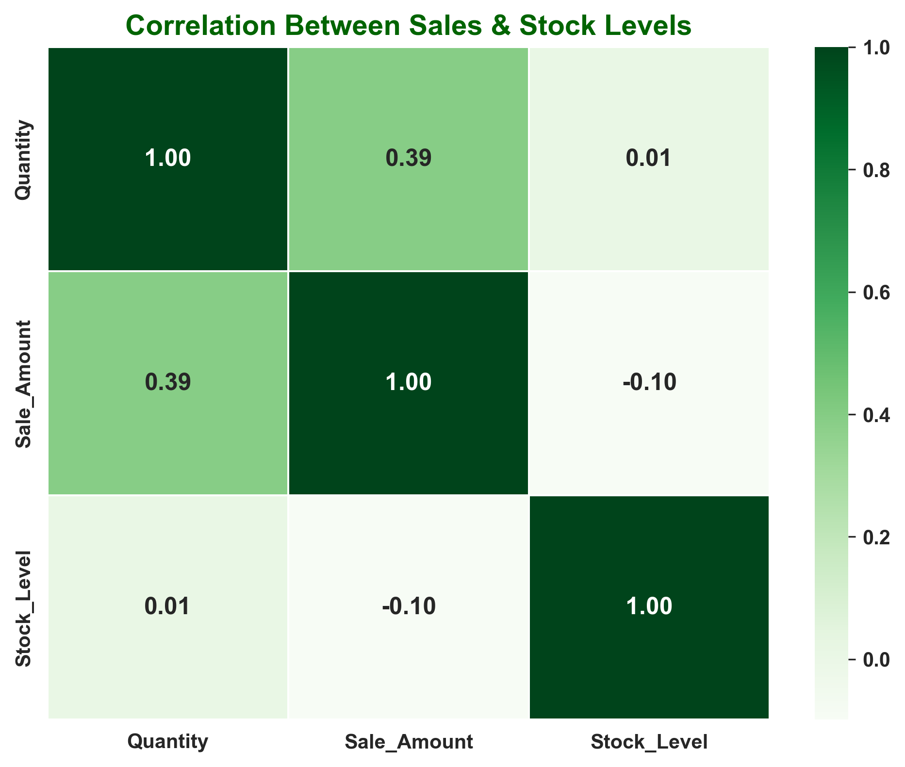
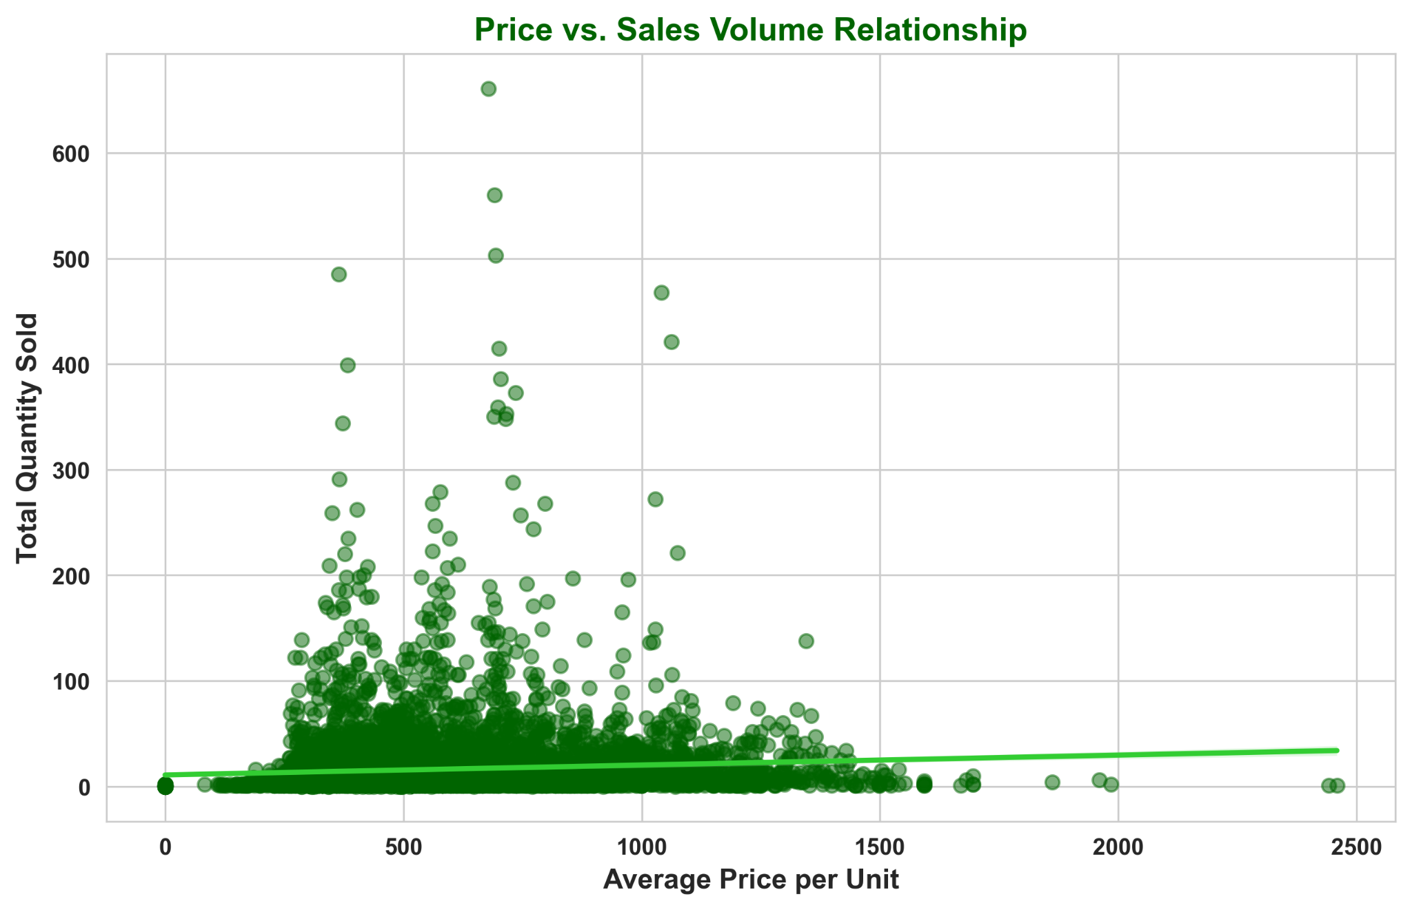
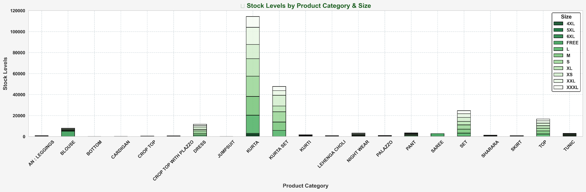
Sales Report Analysis
Insights: Having higher stock levels of certain products such as Kurta and Kurta Set will lead to higher sales generation

Slide 24
Sales Channels
Evaluated profitability variations between different
platforms such as Amazon, Flipkart, and Myntra.

Slide 25
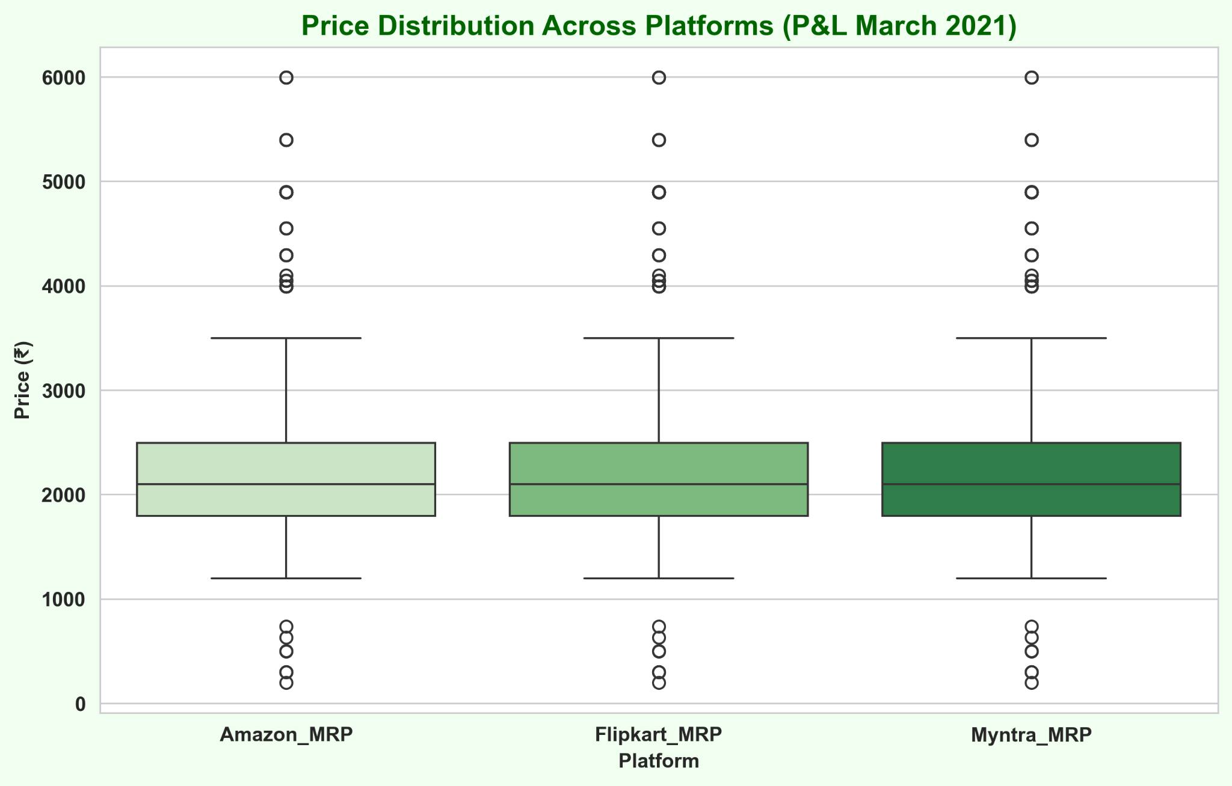
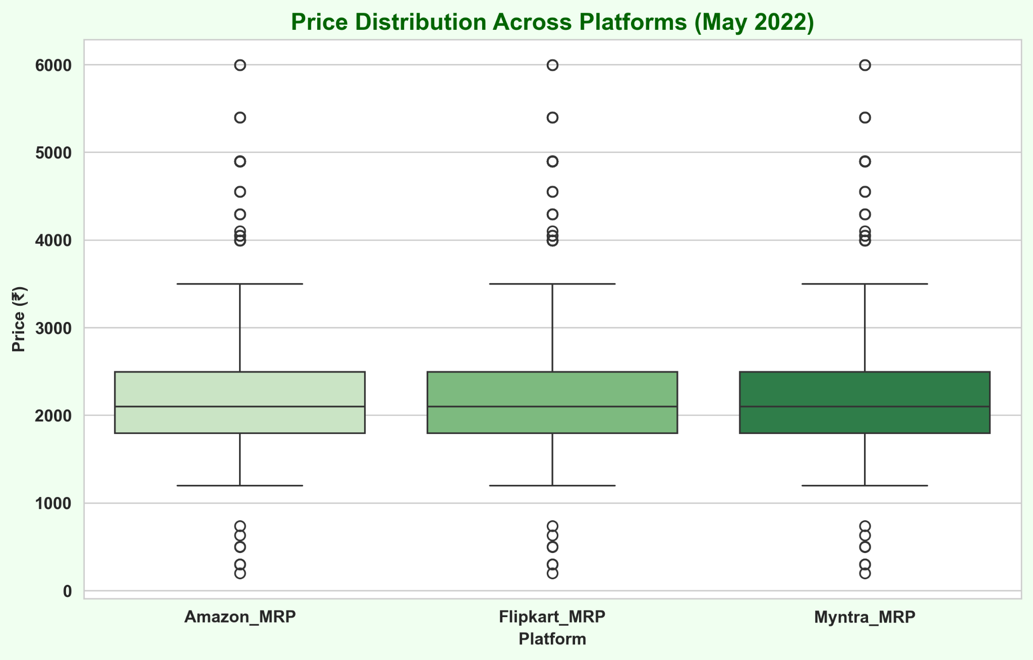
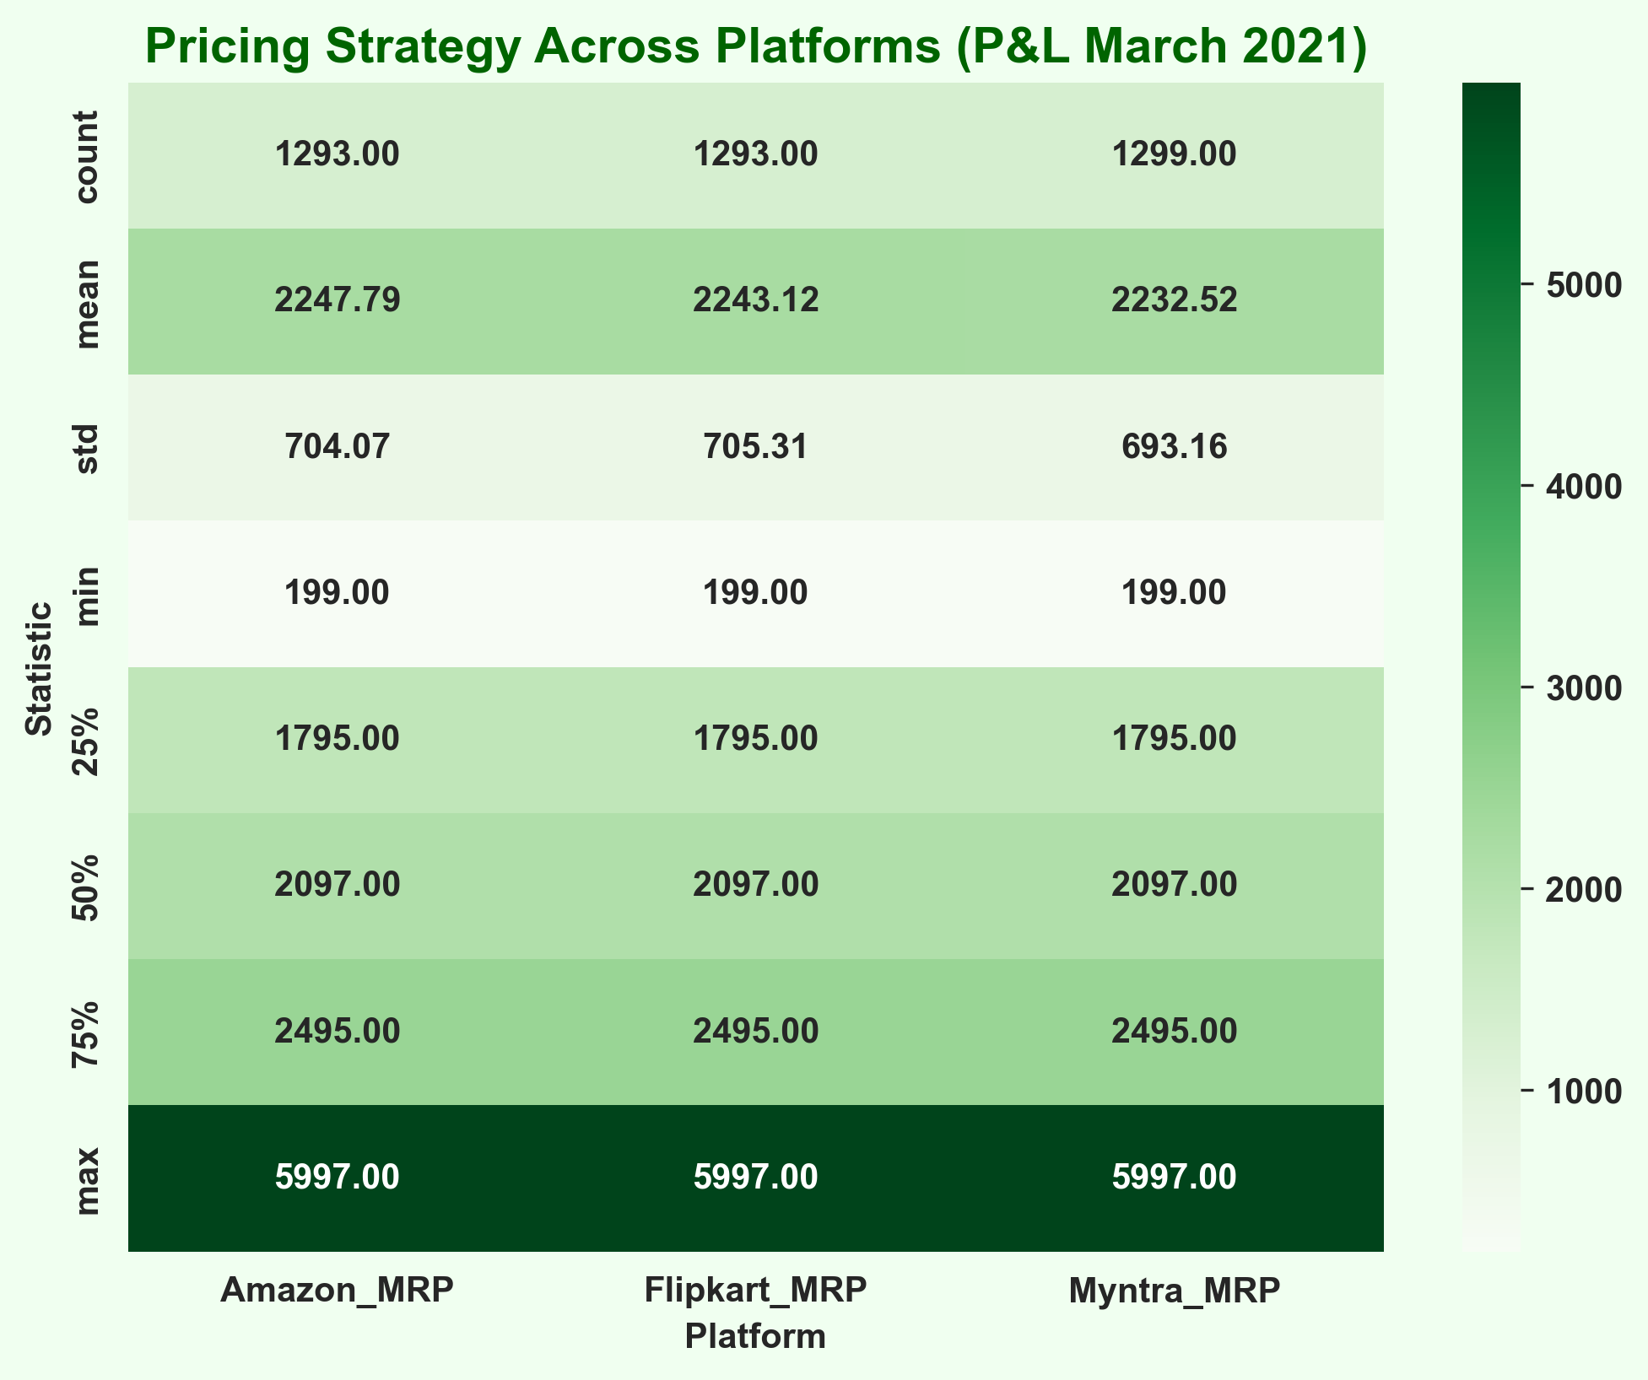

Analysis of P&L March 2021/2022 Compare pricing strategies across platforms (Amazon, Flipkart, Myntra).

Slide 26
Profitability Analysis

Slide 27
Revenue Trends Analysis
April
₹30.76M
36.8%
May
₹27.87M
33.4%
June
₹24.88M
29.4%
March
₹0.11M
0.1%
Monthly Revenue
Q1
₹0.11M
0.1%
Q2
₹83.51M
99.9%
Quarterly Revenue

Slide 28
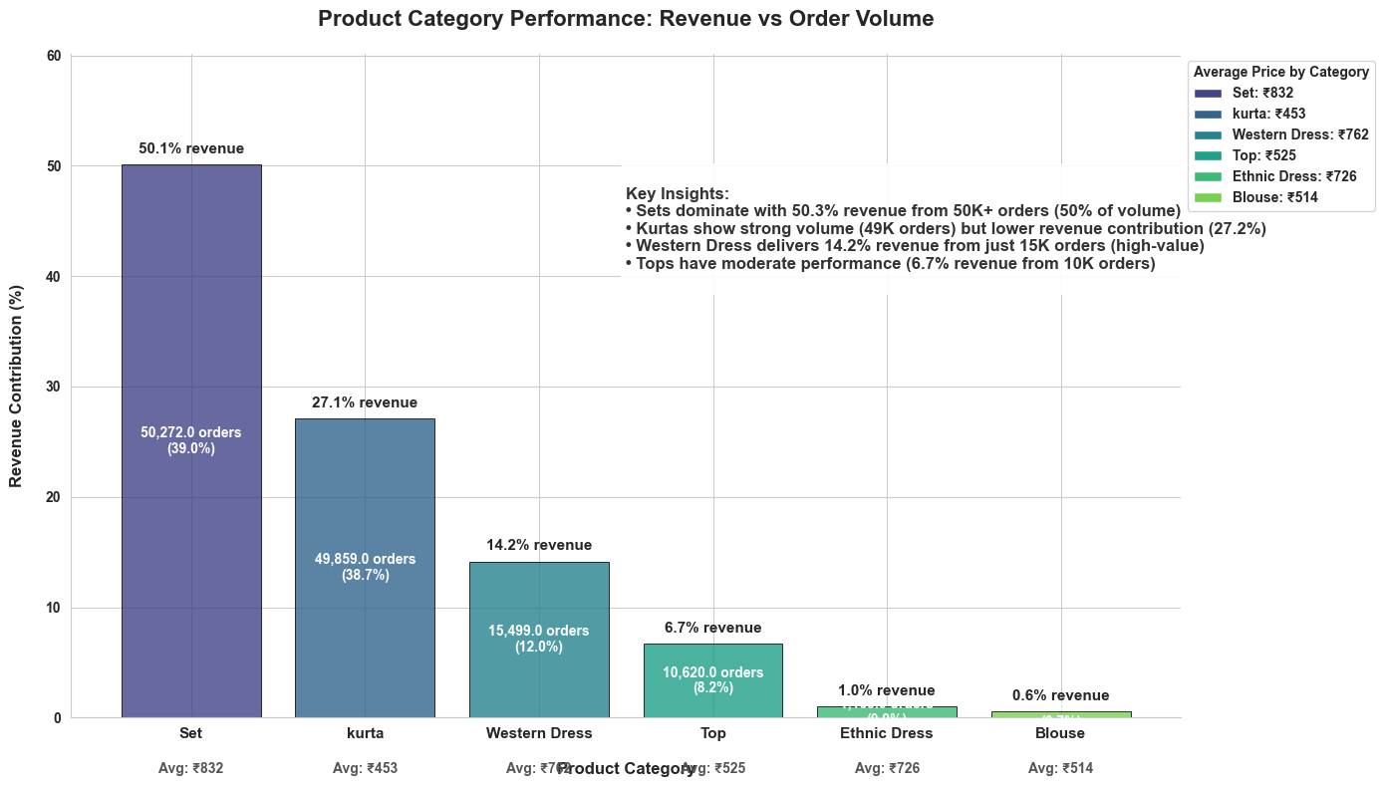
Product Performance
50.1%
Set ( Highest)
₹41.91M
27.1%
Kurta
₹22.68M
14.%
Western Dress
₹11.83M
6.6%
Top
₹5.58M
Top Revenue-Generating Category
01
Highest Revenue Day
Sunday (₹12.76M)
Orders with Promotions
₹674.02
02
Lowest Revenue Day
Thursday (₹11.01M)
Orders without Promotions
₹607.92
03
Average Order Value
B2C: ₹648.46
B2B: ₹704.42
Promotion Analysis
Customer Behavior

Slide 29
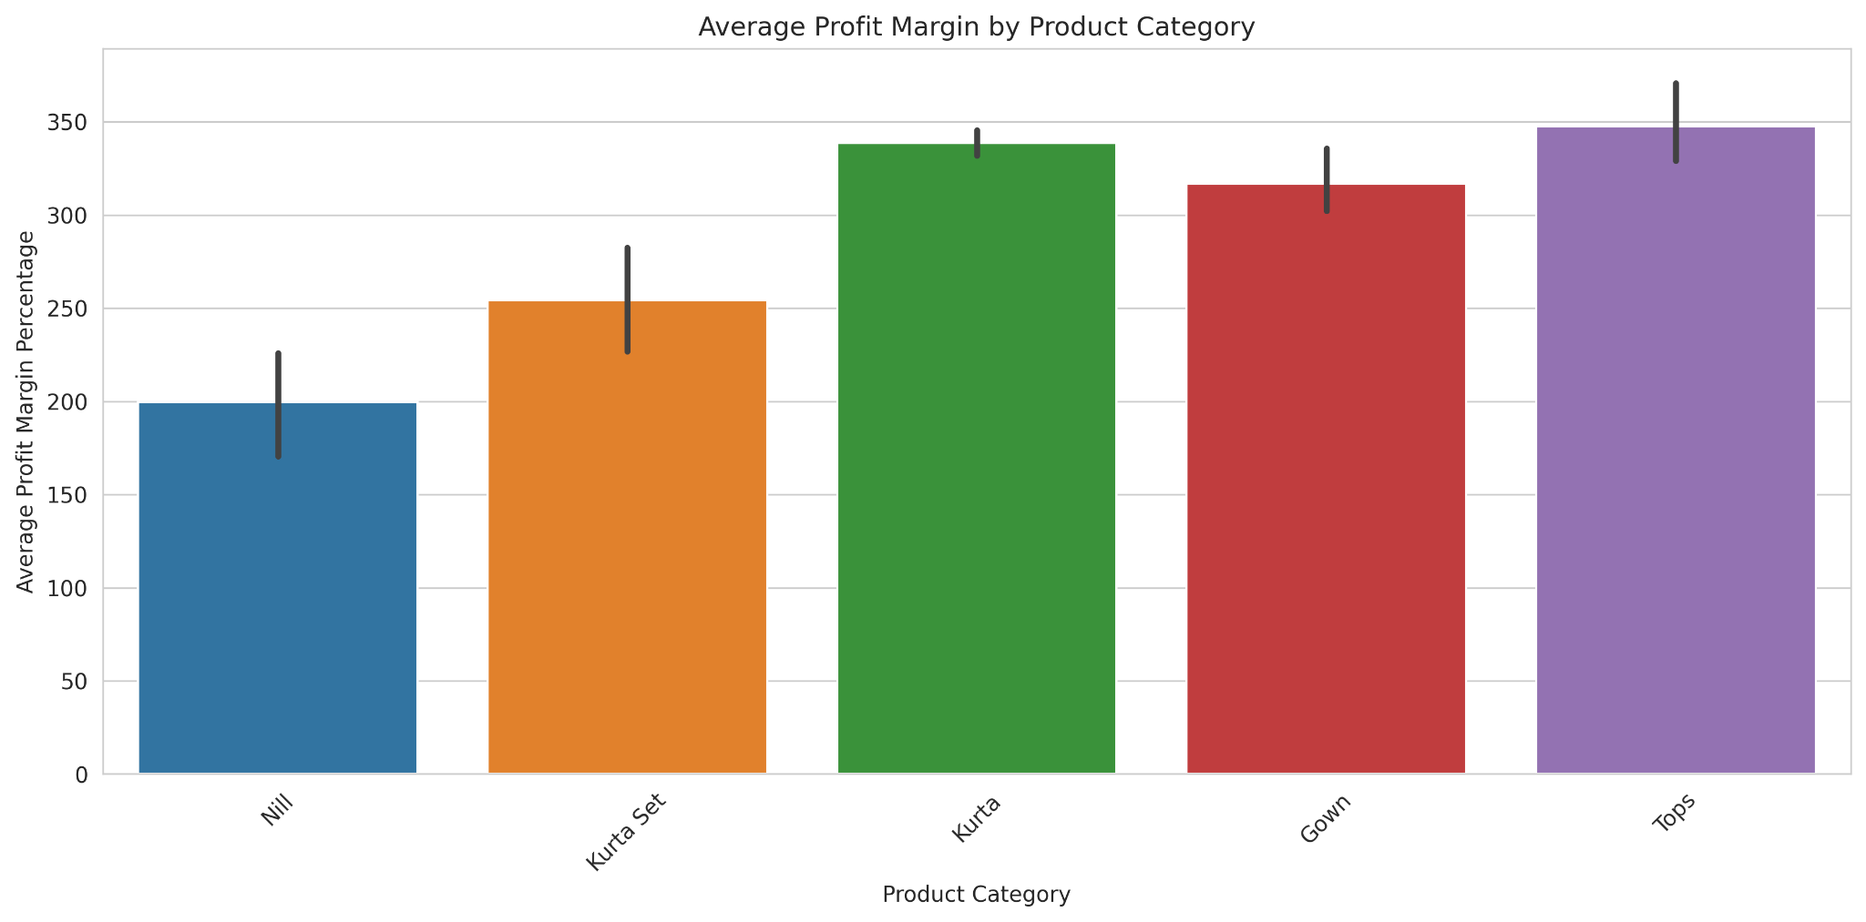
Insights: Categories like Gown/Tops sell less in volume but fetch a higher profit margin.

Slide 30
Basic Statistics of Order & Courier Status
Order Status | Adjustment | Cancelled | Shipped | Unshipped
Cancelled | 6858 | 5838 | 0 | 5629
Pending | 0 | 2 | 10 | 646
Shipped | 0 | 93 | 77580 | 115
Shipped - Delivered | 8 | 0 | 28754 | 0
Shipped - Returned | 3 | 0 | 1947 | 0
Fulfillment Type | Promotion | Count
Amazon | Yes | 47459
Amazon | No | 42219
Merchant | Yes | 32338
Merchant | No | 6926
Summary of Orders by Status and Courier Status
Statistics of Merchant and Promotion
60.3%
Shipped (Most Orders)
22.3%
Delivered Orders
14.2%
Cancellation Rate
Operational Metrics

Slide 31
Customer Insights

Slide 32
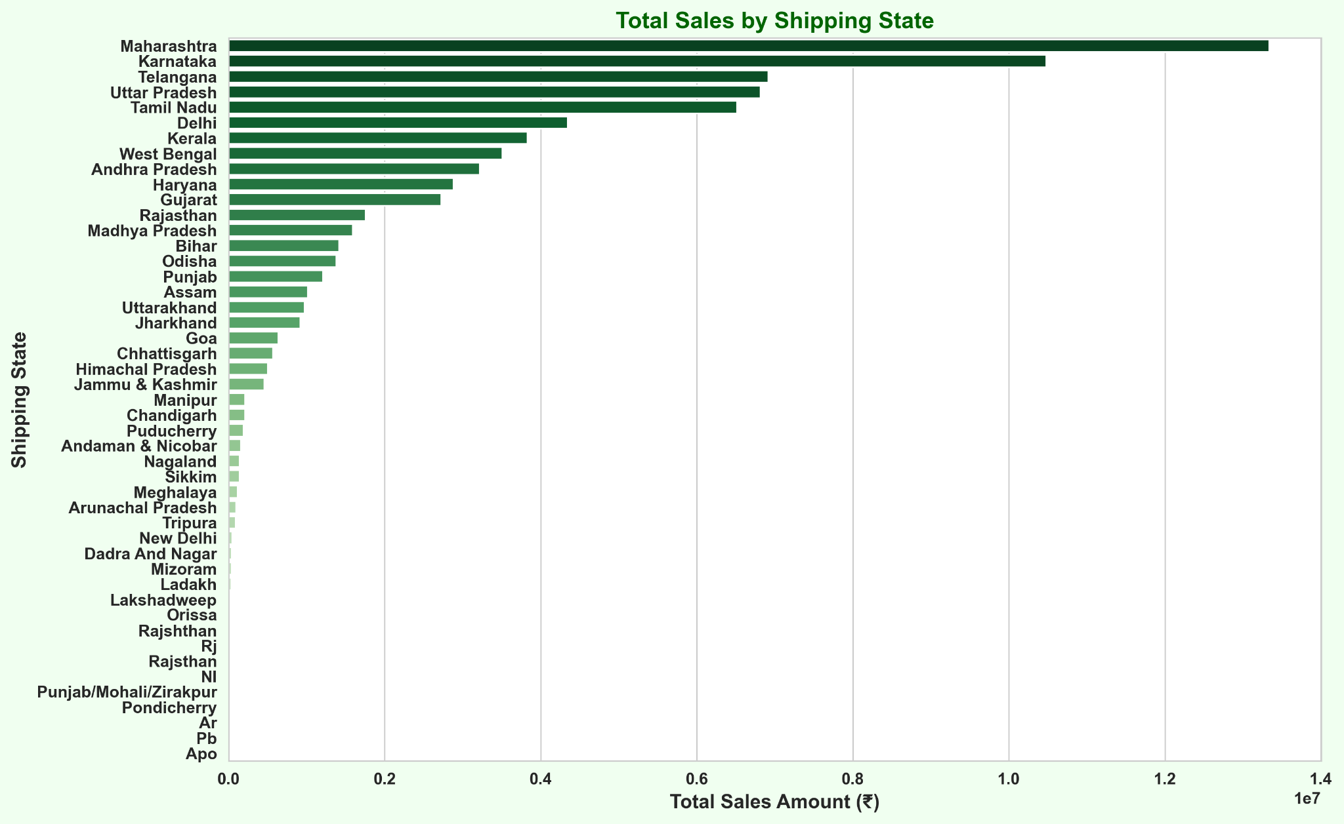
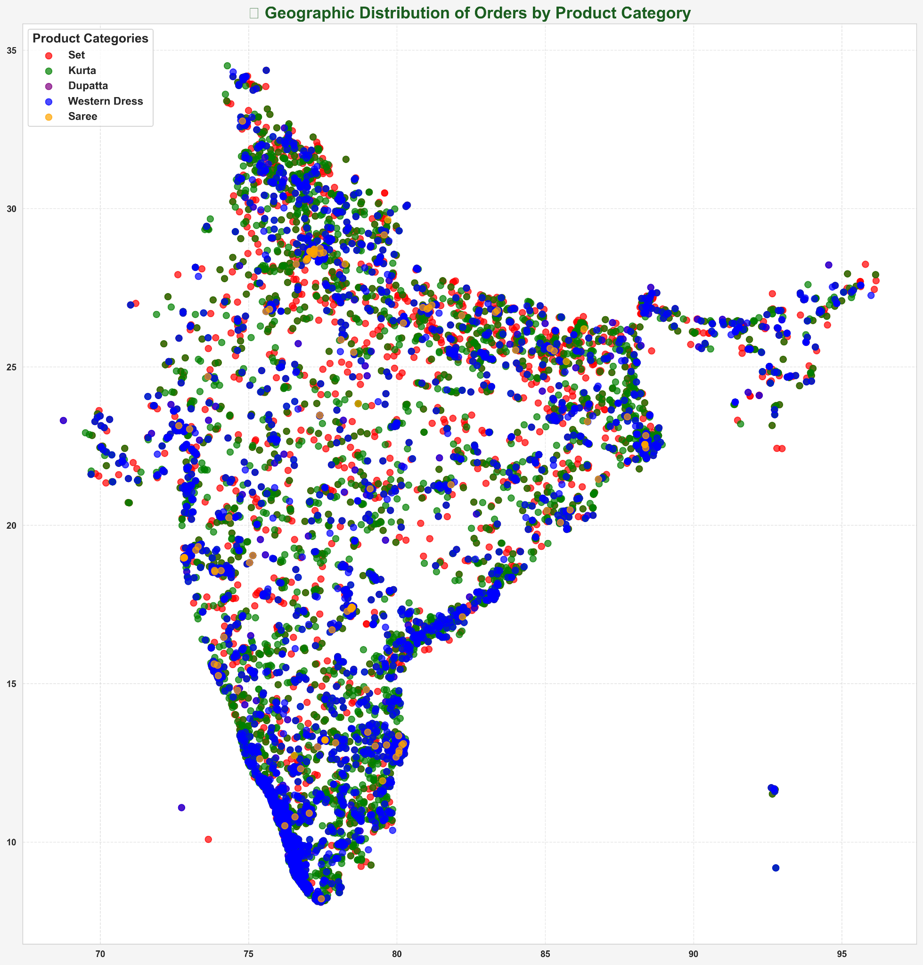
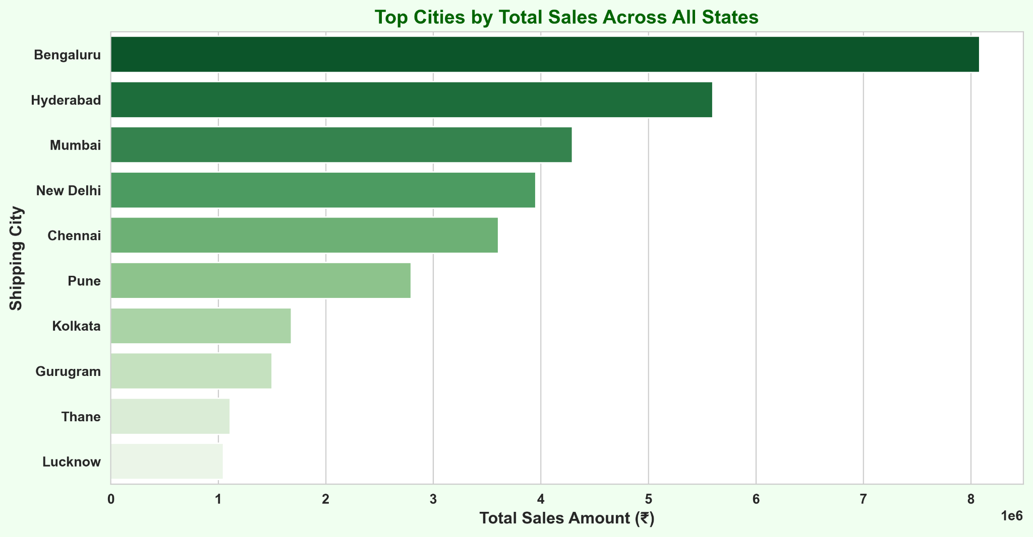
Geographic Distribution of Orders: States and Cities
Geographic Distribution of Orders by Product Category"
Top 3 States by Revenue
01 - Maharashtra: ₹14.09M 02 - Karnataka: ₹11.07M
03 - Telangana: ₹7.35M
Geographical Insights

Slide 33
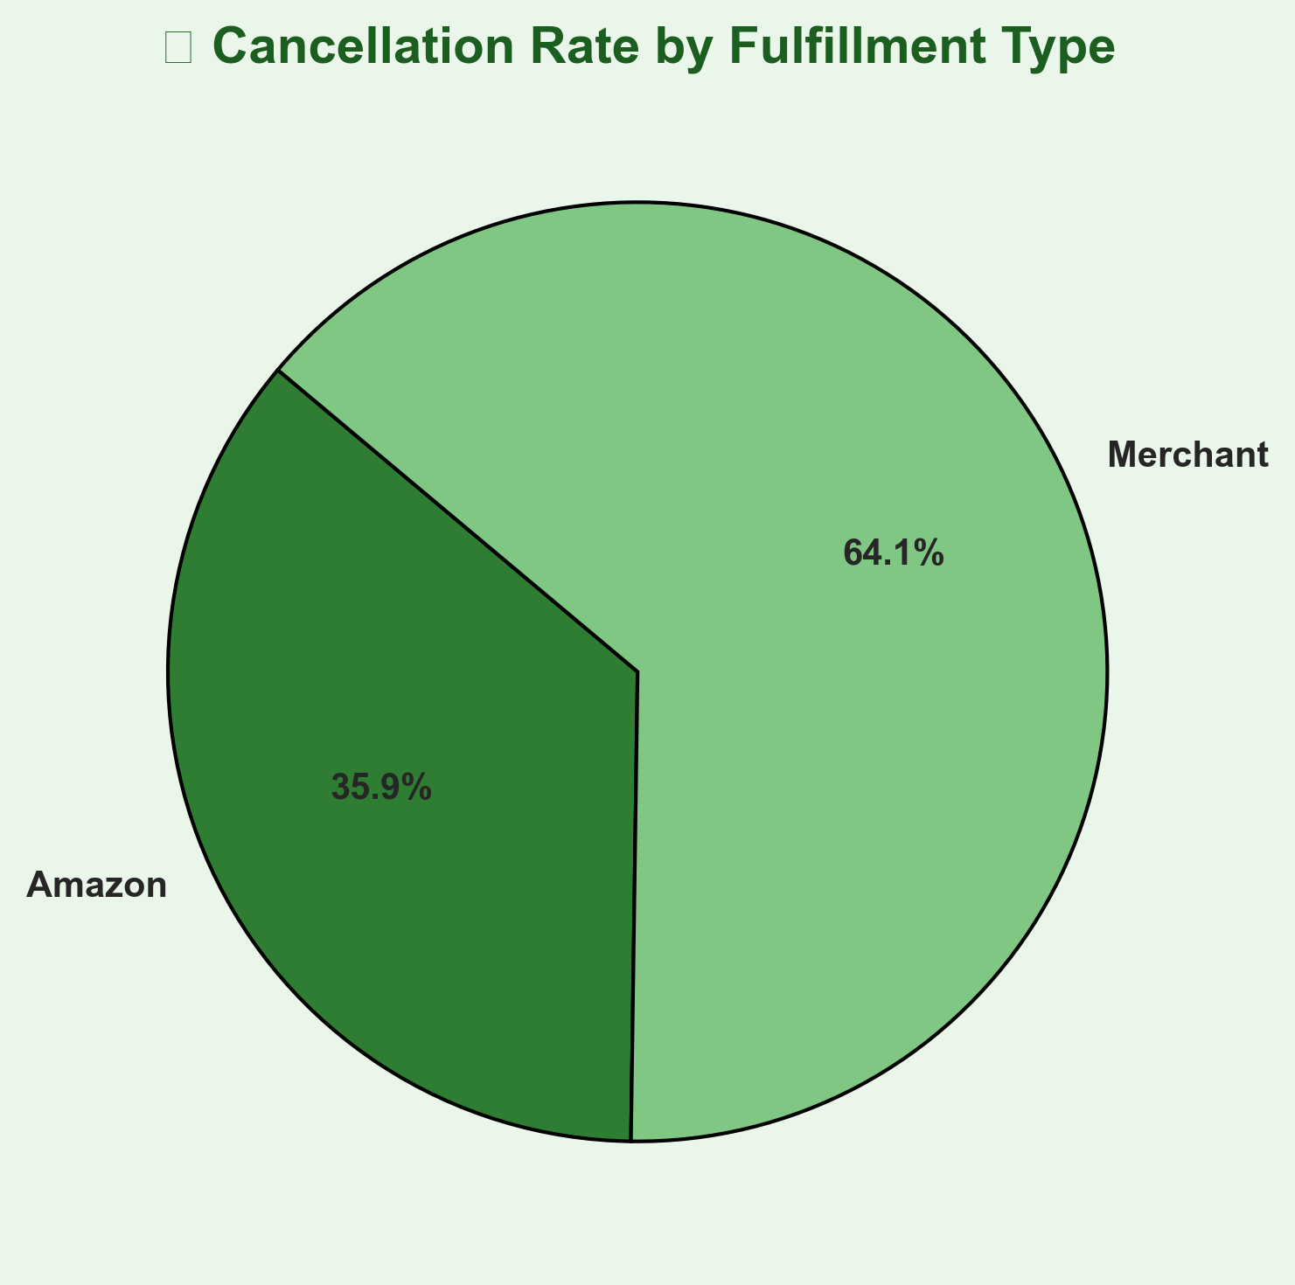
Impact of Promotions on Cancellations:
Category | Count | Percentage
Cancelled Orders with Promotion | 2396 | 3.00%
Cancelled Orders without Promotion | 18035 | 36.69%
Fulfillment Type | Cancelled Orders | Cancellation %
Amazon | 11467 | 12.79%
Merchant | 8964 | 22.83%
Cancelled & Returning Orders with Promotions
Cancellations by Fulfillment Type
Insights:
Orders with promotions have significantly lower cancellation rates
Merchant-fulfilled orders have a higher cancellation rate than Amazon-fulfilled ones..

Slide 34
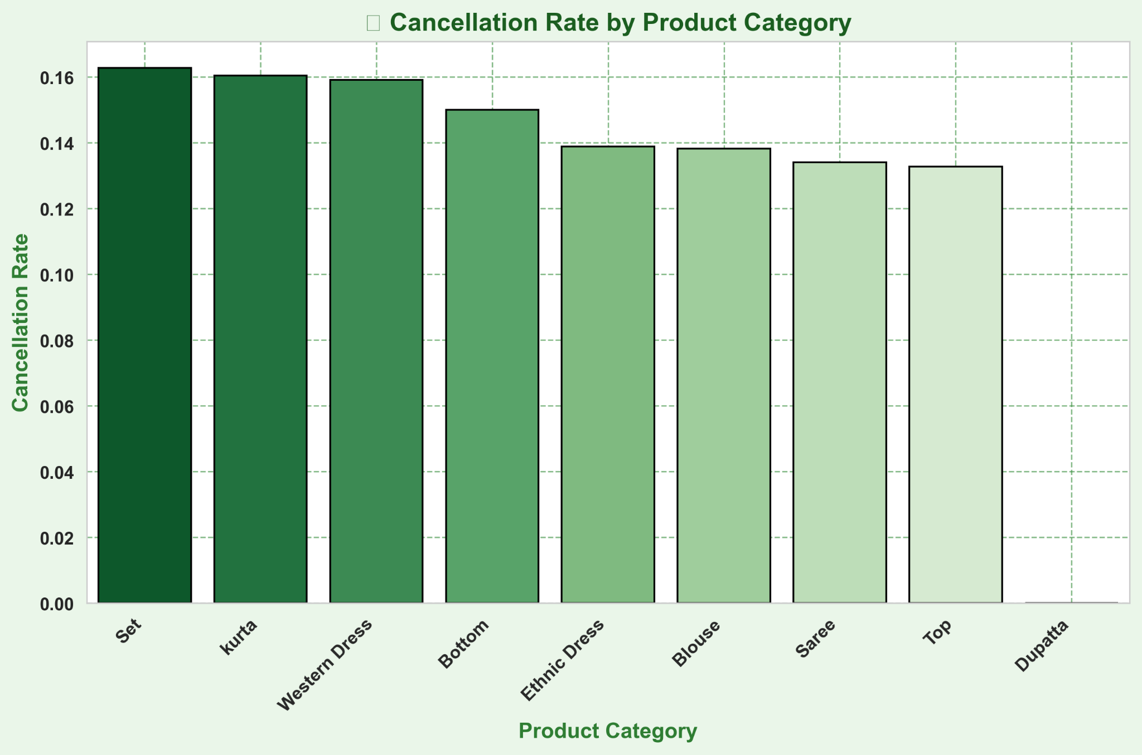
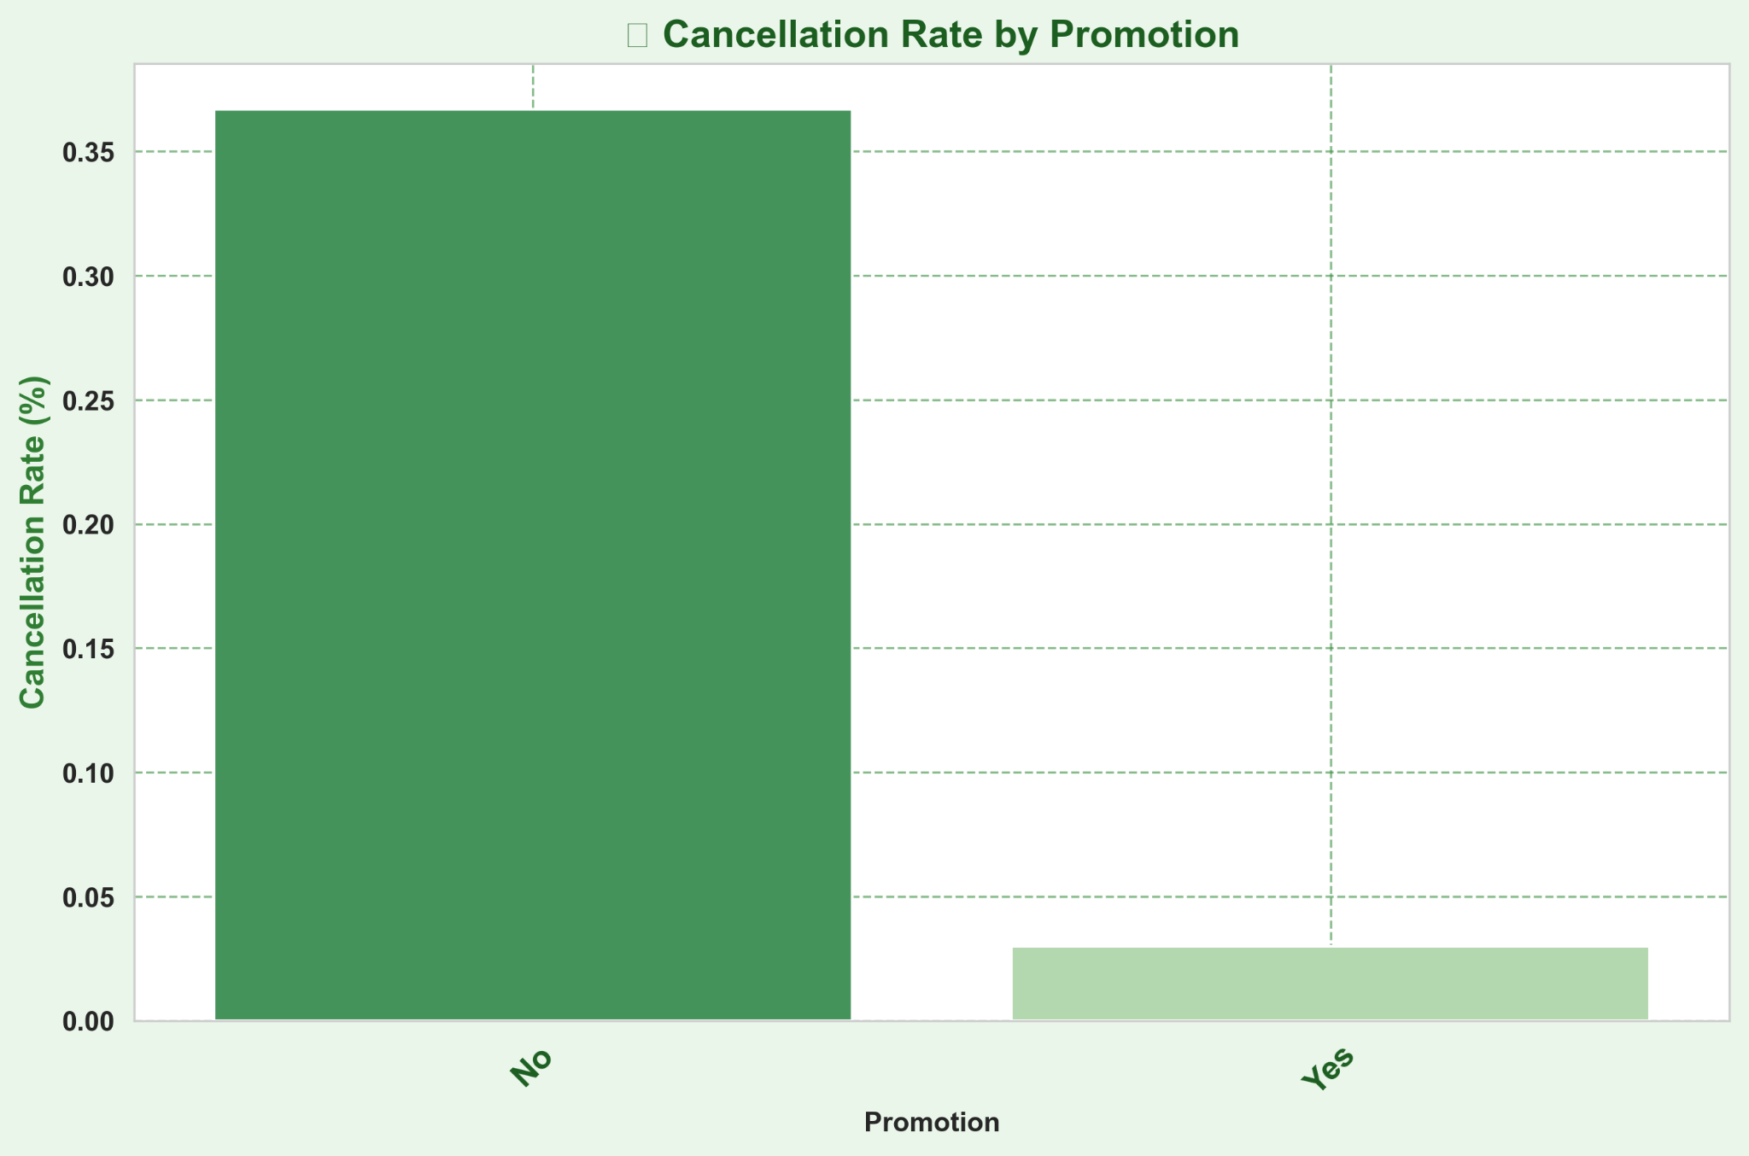
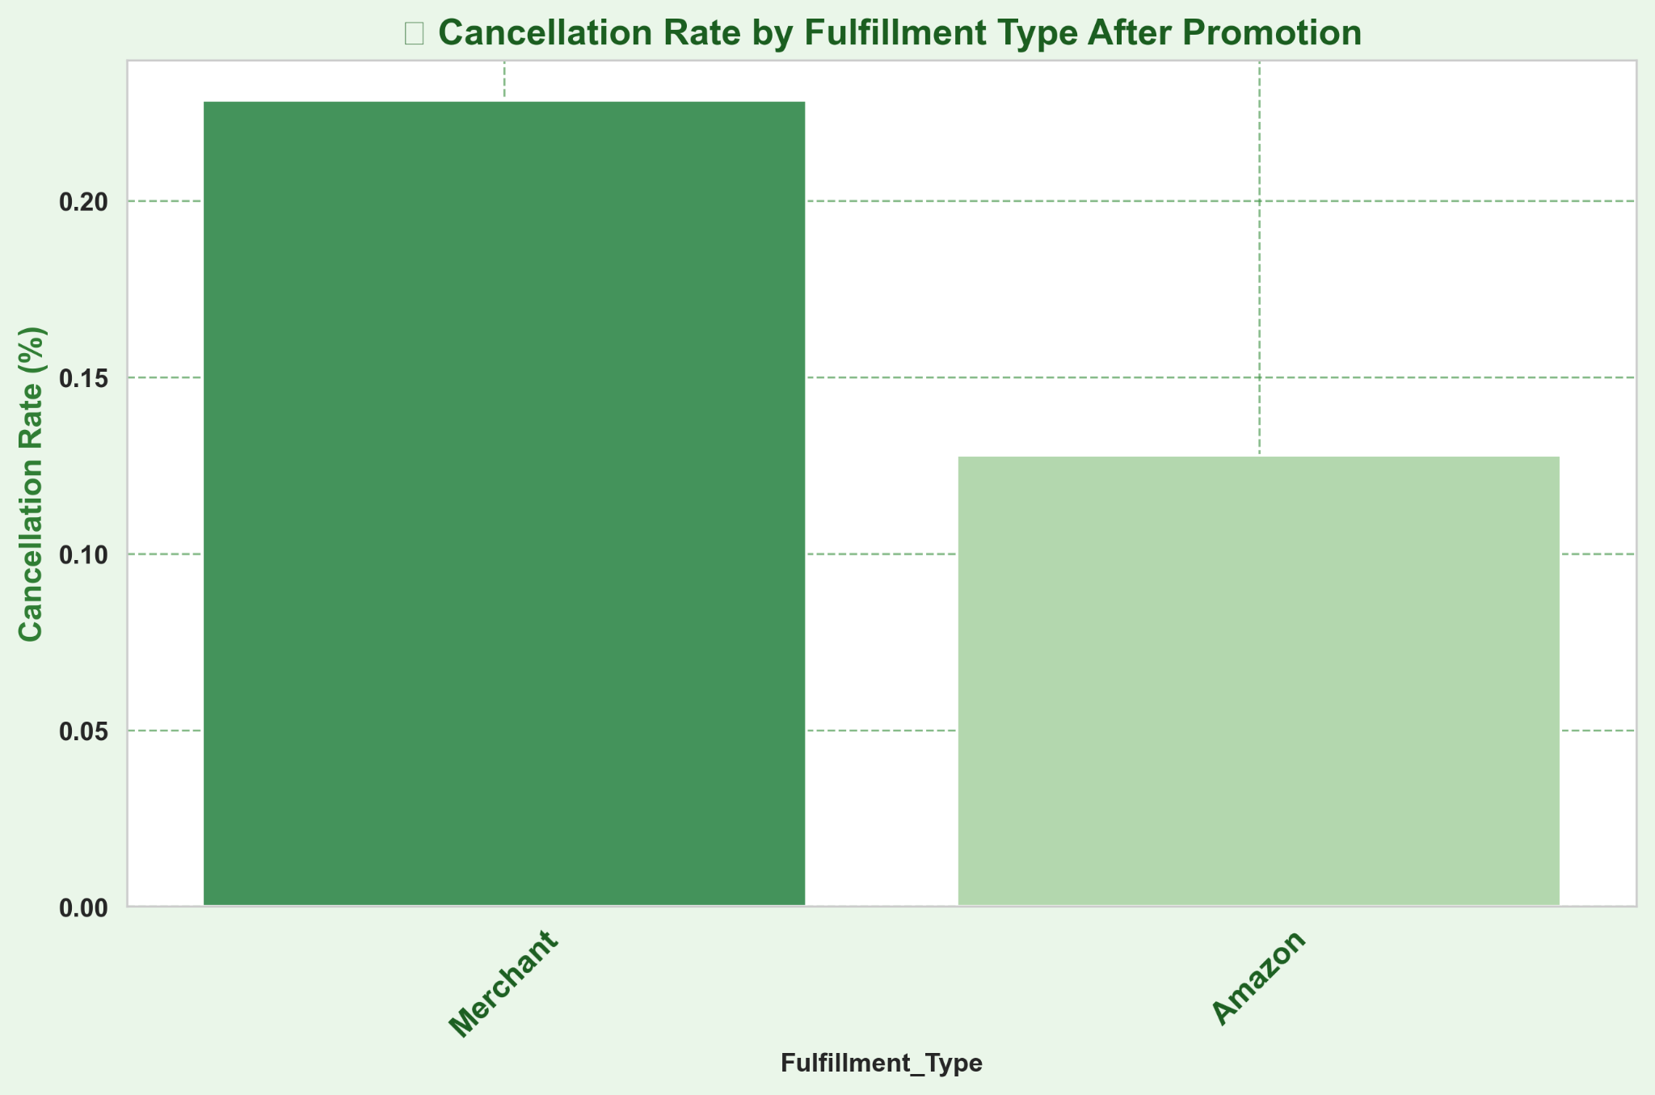
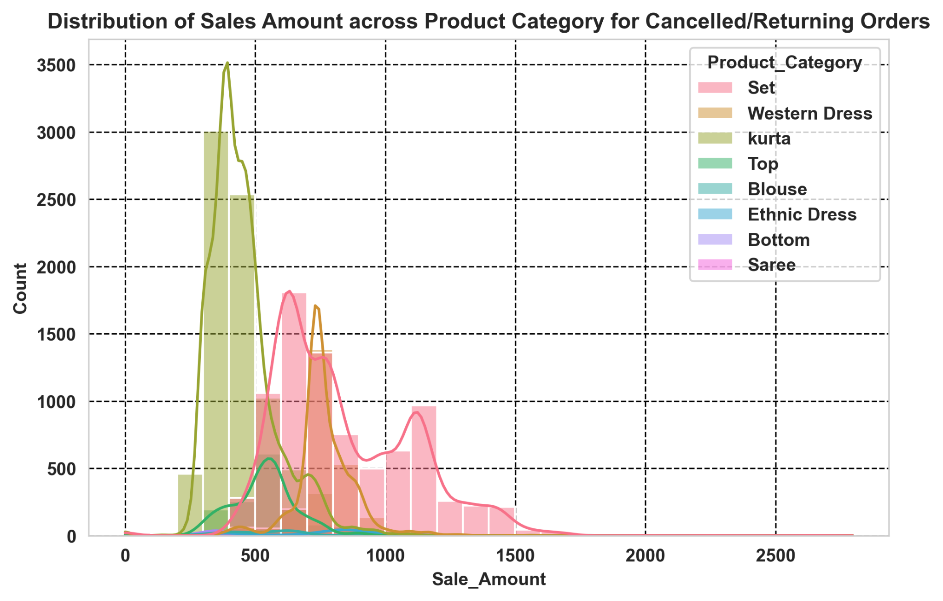
Cancellation Rate
Insights:
Cancellation Rate seems to be higher when there is no promotion is given
Merchant’s self logistics seem to bring more cancellations - perhaps due to longer delivery time?

Slide 35
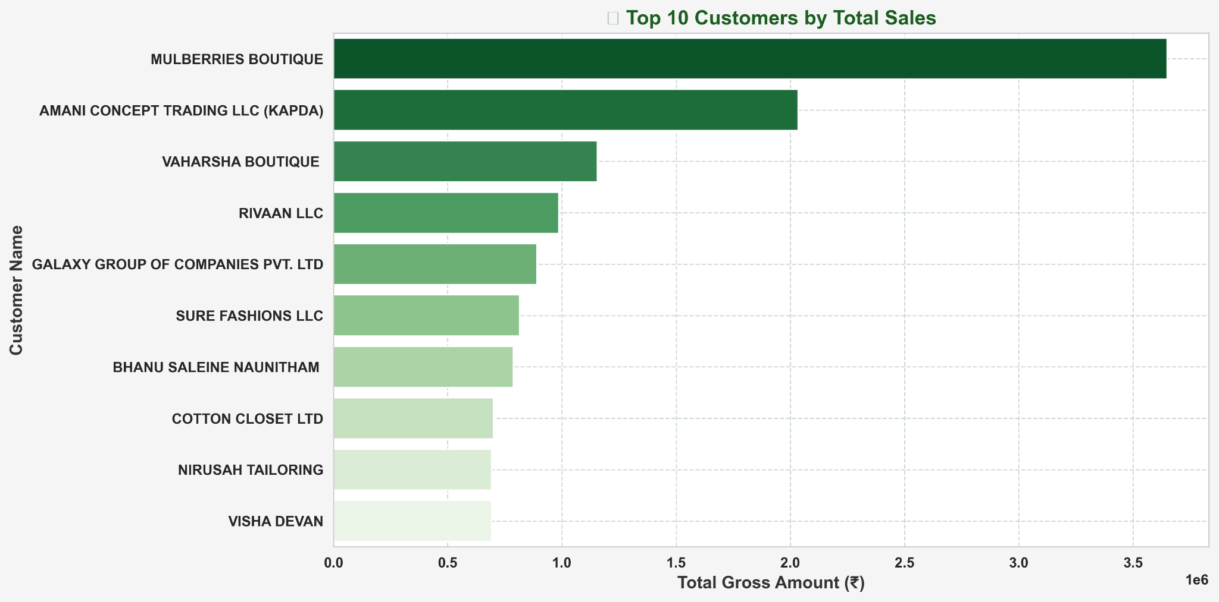
Top International Customers

Slide 36
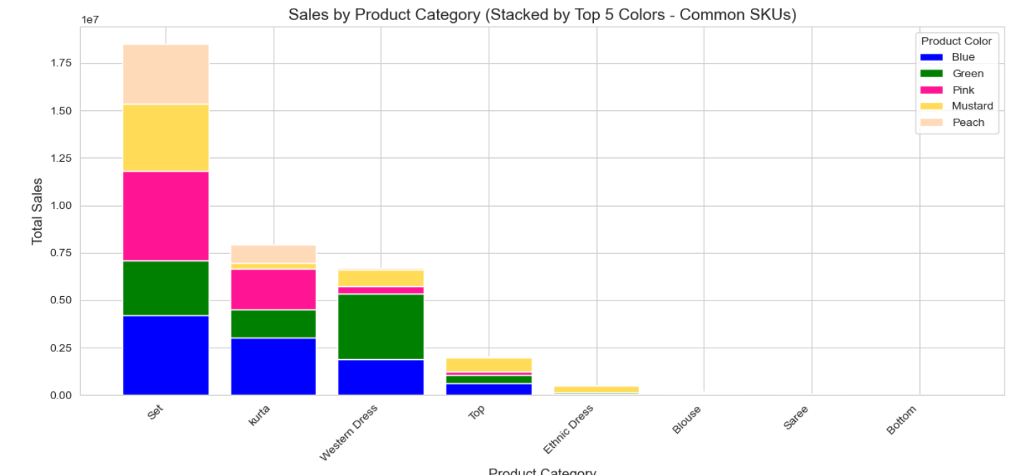
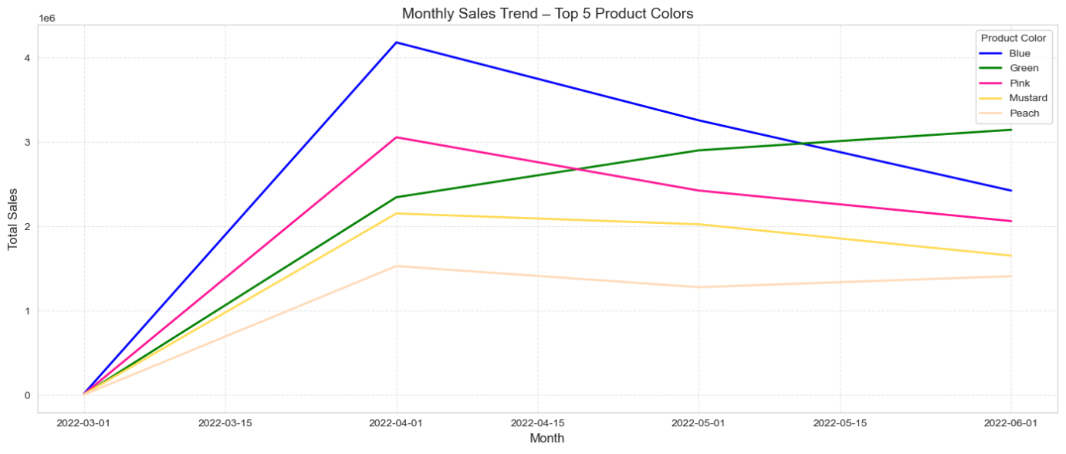
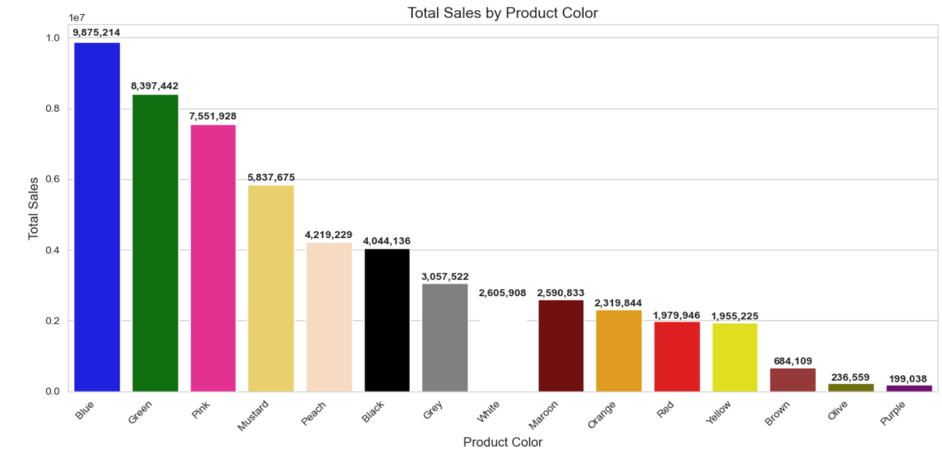
Sales trends based on Colors
Top 5 colors contributing to sales:
Blue
Green
Pink
Mustard
Peach

Slide 37
Strategic Recommendations
1. Optimize Logistics
Use Shiprocket for high-return items (lower costs).
Partner with INCREFF for short-term/seasonal needs (e.g., Dupattas in June).
2. Inventory Management
Stock More Kurta & Kurta Sets (year-round bestsellers).
Focus on Gowns/Tops for higher margins (lower volume, higher profit).
3. Reduce Cancellations
Prioritize Amazon Fulfillment for speed-sensitive items.
Run Promotions on merchant-fulfilled orders to offset delays.
4. Seasonal Marketing
March: Pre-peak campaigns for Kurta Sets (April demand spike).
April-May: Push Western Dresses/Tops (summer/wedding season).
5. Profit Boosters
Premium Pricing: Market Gowns/Tops as occasion wear.
Leverage Top Colors: Blue, Green, Pink in ads & displays.

Slide 38
Thanks
LUMIGRAPH

